Slide 1


DISORDERS OF POTASSIUM BALANCE
Prof. Dr. Tekin AKPOLAT
Liv Hospital-İSTANBUL
Istinye University School of Medicine
2025-2026
www.tekinakpolat.com

Slide 2
Patient 1
82 years old, female
Found by neighbors and brought to the emergency
Unconscious, stool and urine at panties
Medical history unknown, no drug at home
Dehydrated, BP: 72/10, Pulse 102/min, Respiration 42/min
Neurological examination unremarkable
42 kg

Slide 3
Patient 1 (continued)
BUN: 41 mg/dl, Creatinine 2.6 mg/dl
Na 132, K 2.2, Cl 113, HCO3: 7
Anion gap: 12
Arterial blood gases
pH: 7.26, PCO2: 16 PO2: 76 mmHg
What are the patient’s problems?

Slide 4
Problems
Hypovolemia
Metabolic acidosis
Prerenal azotemia
Hypopotasemia
What is the cause of hypopotasemia?
Can it be psuedohypopotasemia?
Translocational or defficiency?

Slide 5
Causes of hypopotasemia
1.Decrease of intake
2.Increase of loss: Renal or extrarenal
3.Deterioration of intracellular-extracellular potassium distribution

Slide 6
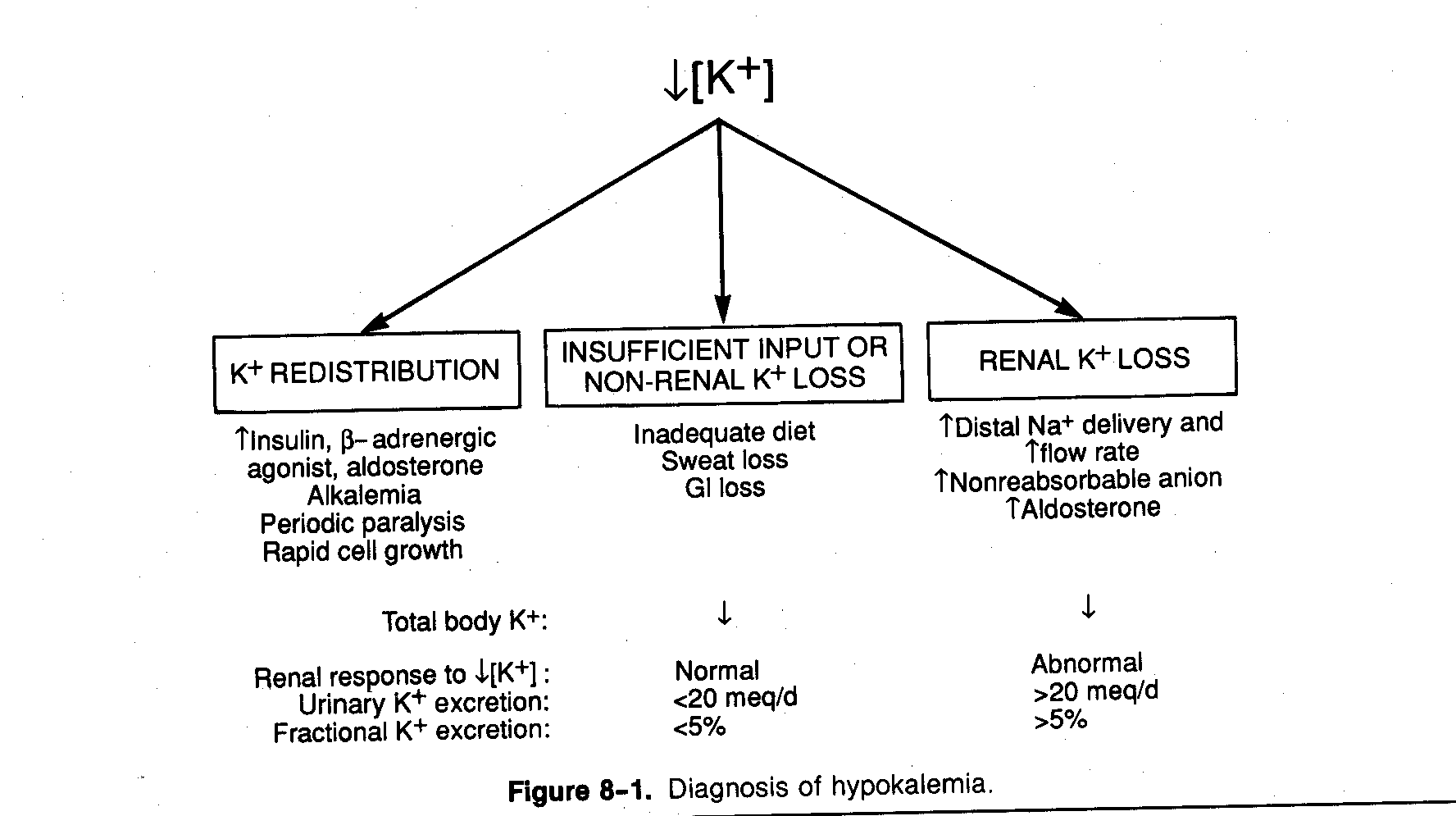

Slide 7
Factors increasing intracellular potassium
Insulin
Alkalosis
Beta2 adrenergic agonist
Alpha adrenergic antagonist
Aldosterone
Other causes
Decrease plazma potassium

Slide 8
Factors decreasing intracellular potassium
Acidosis
Hyperosmolality
Hyperglycemia
Alpha adrenergic agonist
Beta2 adrenergic antagonist
Exercise
Other causes
Increase plazma potassium

Slide 9
What do you expect at ECG?

Slide 10
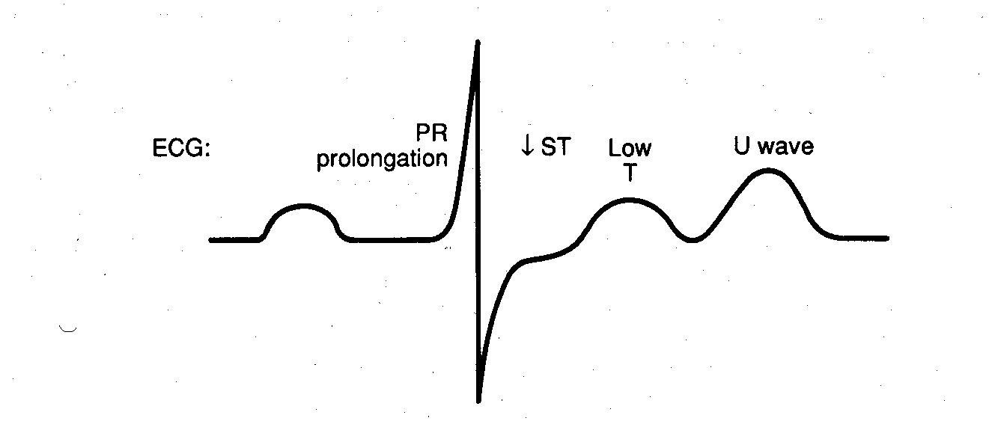

Slide 11
Interpretation
Absence of drug history causing distribution, severity of hypopotasemia, hypovolemia and metabolic acidosis suggest potassium deficiency
Diuretic caused hypopotasemia is related to metabolic alkalosis
There are two causes of normal anion gap metabolic acidosis: Stool loss or Renal tubular acidosis

Slide 12
What is potassium deficit?
Each 0.3 mEq/l of potassium decrease show 100 mEq deficiency
In this patient, from 4 to 2.2 (=1.8)
1.8/0.3 x 100 = 600 mmol

Slide 13
Practical information
In potassium deficiency, each 1 mEq/L decrease of plasma potassium means loss of 200-350 mEq potassium loss from the body

Slide 14
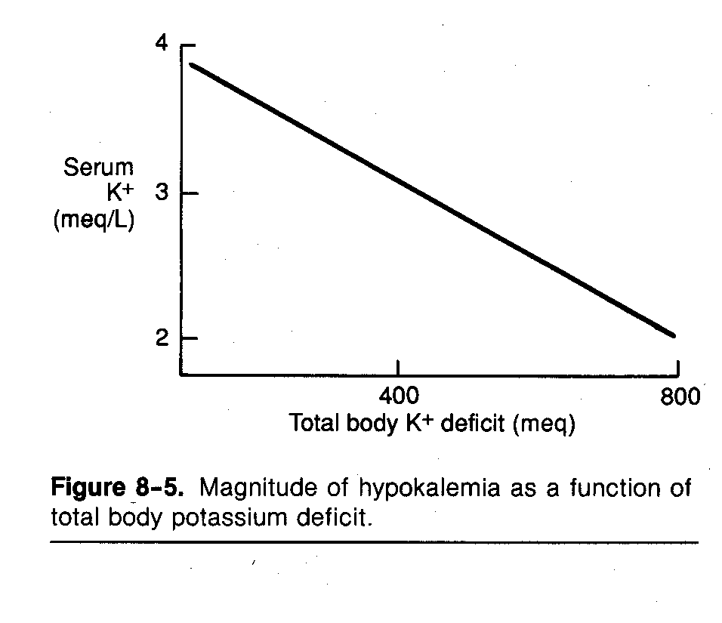

Slide 15
How do you plan treatment
Intravenous Fluid (% 5 Dx – %0.9 NaCl)
Treatment of hypovolemia
Potassium
Bicarbonate

Slide 16
Potassium treatment (1)
KCl is preferred
In bicarbonate deficiency potassium bicarbonate or potassium citrate (better tolerated)
In phosphate deficiency (e.g. diabetic ketoacidosis) ketoasidoz) potassium phosphate
In general, potassium in food is not KCl, therefore, less effective

Slide 17
Potassium treatment(2)
Fluid consisting of 40-60 mEq potassium should be given at a rate of less than 20-40 mEq/hour
Except unusual conditions, total daily amount must not exceed 200 mEq
In nonemergent conditions, potassium infusion of more than 10 mEq/hour (solution consisting of 40 mEq potassium) by peripheral veins may cause sclerosis

Slide 18
INTERTPRETATION
Do not forget hypovolemia treatment

Slide 19
Patient 2
72 years old, female
Diabetes mellitus, coronary artery disease and heart failure
Medicines: insulin and digoxin
Admitted to the emergency service with coma
Blood pressure: 82/52 mmHg

Slide 20
Patient 2 (continued)
BUN: 36 mg/dl, Creatinine 1.7 mg/dl
Serum glucose 820 mg/dl, urinary ketone +
Na 128, K 4, Cl 94, HCO3: 5
Anion gap: 29
Arterial blood gases
pH: 7.02, PCO2: 20 PO2: 82 mmHg
What are the patient’s problems?

Slide 21
Problems
Prerenal azotemia (related hypovolemia)
Hypotension, hypovolemia
Hyperglycemia
Hyponatremia
Metabolic acidosis with increased anion gap

Slide 22
How do you treat hyponatremia?

Slide 23
How do you treat hyponatremia?
Translocational hyponatremia
Cause hyperglycemia
Treatment of diabetic ketoacidosis
Does this patient have a problem with potassium balance?

Slide 24
K balance
Decreased
Hyperglycemia may cause sodium and potassium loss by diuresis
Metabolic acidosis and insulin deficiency shifts potassium from intracellular to extracellular space
Plasma potassium normal despite decrease of body potassium
After diabetic ketoacidosis treatment potassium moves to intracellular space and hypopotasemia appears

Slide 25
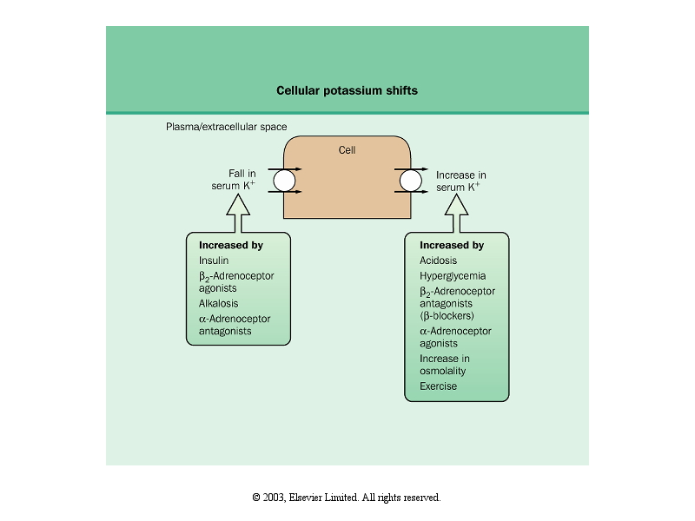

Slide 26
Translocational hypopotasemia
Each 0.1 decrease of pH increases potassium by 0.6 mEq/l (This effect is more prominent in nonorganic acidosis compared to organic acidosis and respiratory acidosis)
Each 10 mOsm/kg increase of osmolality increases potassium by 0.6 mEq/l

Slide 27
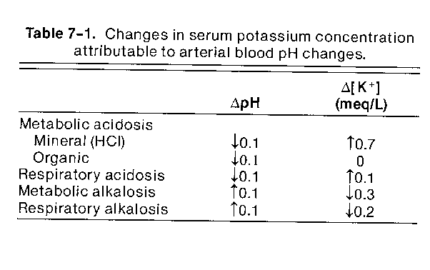

Slide 28
Organic acidosis
HCl (nonorganic acid) increases plasma potassium because Cl can not enter cell
Organic anion in ketoacidosis or lactic acidosis enters cell with H

Slide 29
What are the lessons
Patient must be evaluated from all aspects
Check volume status first
Anion gap must be calculated in all critical patients
Total body potassium may decrease despite normal plasma potassium
You should memorize problems arising in common fluid-electrolyte metabolism disturbances
Memorization may not be enough
Theoretical information is important

Slide 30
Patient 3
63 years old, male
Admitted to the emergency because of syncope
History of alcohol: +
Physical examination: Conculsion +, 101/55 mmHg, Pulse 44/min, Respiration 20/min, fever 38.5 º C (rectal)
Focal neurologic deficit -, CSF normal
Urine examination: Hemoglobin 4+, erythrocyte 2/HPF, leukocyte > 20/HPF

Slide 31
Patient 3 (continued)
BUN: 18 mg/dl, Creatinine 3 mg/dl
Na 128, K 9.1, Cl 98, HCO3: 8
Anion gap: 22
Arterial blood gases
pH: 7.15, PCO2: 24 PO2: 78 mmHg
Other findings

Slide 32
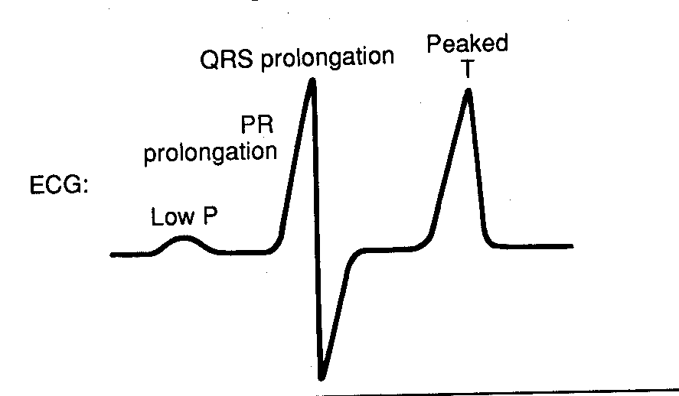
COMPLETE BLOCK CAN OCCUR

Slide 33
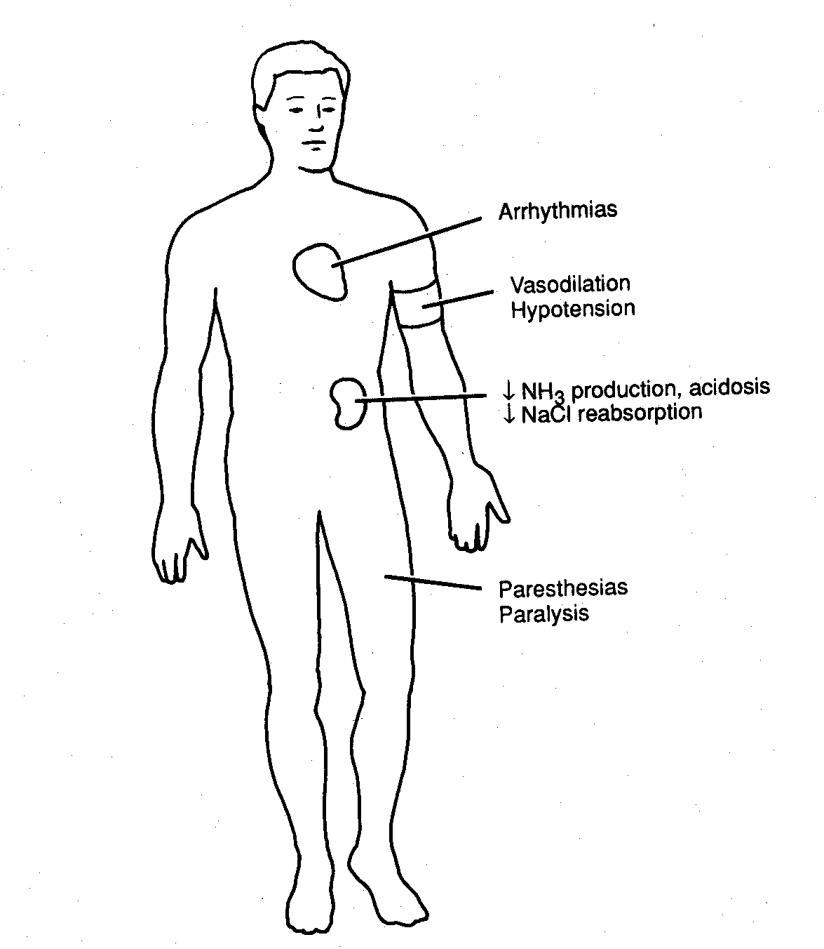

Slide 34
Cause of hyperpotasemia in this patient?

Slide 35
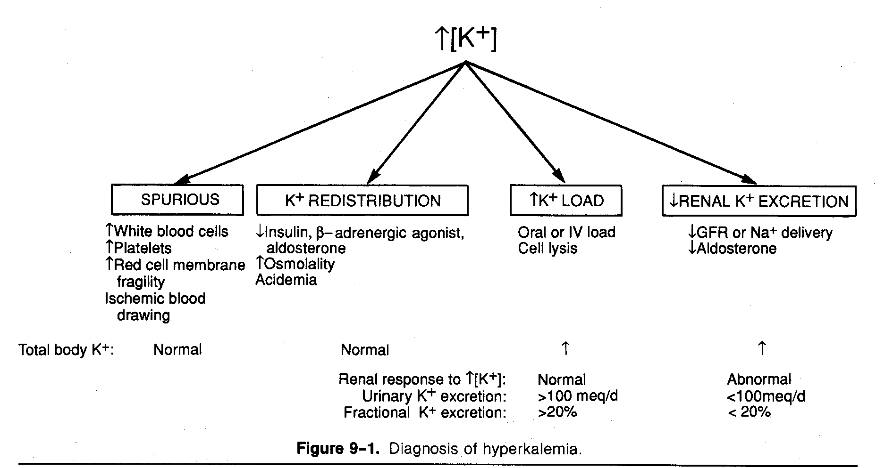

Slide 36
Pseudohyperpotasemia
Hemolysis of blood and increase of thrombocytes or leukocytes may cause pseudohyperpotasemia
Each 100.000/mm3 increase of thrombocytes increases potassium by 0.15 mEq/l

Slide 37
Translocational hyperpotasemia
Each 0.1 decrease of pH increases potassium by 0.6 mEq/l (This effect is more prominent in nonorganic acidosis compared to organic acidosis and respiratory acidosis)
Each 10 mOsm/kg increase of osmolality increases potassium by 0.6 mEq/l

Slide 38
Patient 3 (Hyperpotasemia causes)
Alcohol history suggests decrease of body potassium
No signs of pseudohyperpotasemia
Acidosis can not explain K 9.1 alone
No history of medicine
Kidney failure does not explain alone
There is no excess potassium intake or impaired potassium excretion
What is the cause?

Slide 39
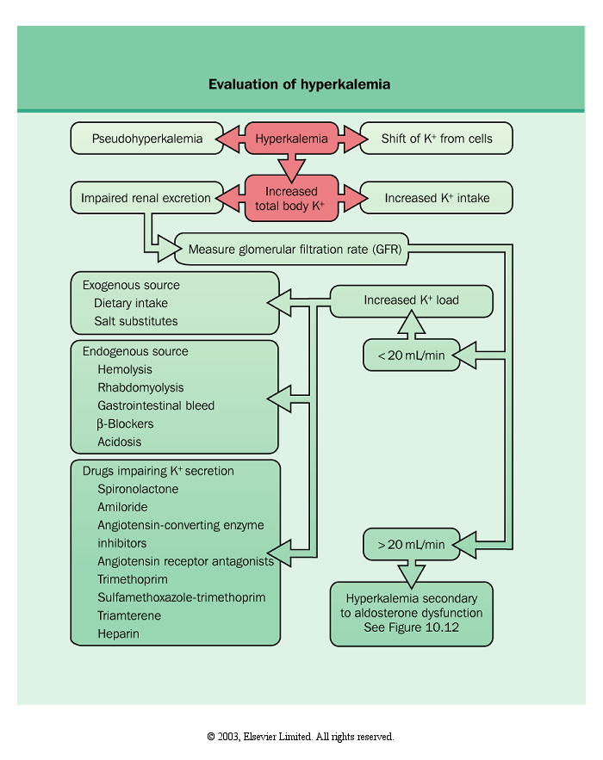

Slide 40
Patient 3 (Interpretation)
Potassium must come from intracellular
Rhabdomylosis and hyperpotasemia due to rhabdomylosis
What are other findings supporting rhabdomylosis in this patient?

Slide 41
Findings supporting rhabdomylosis
Urine examination: Hemoglobin 4+, erythrocyte 2/HPF
BUN: 18 mg/dl, Creatinine 3 mg/dl
CPK level 12.000 U/l

Slide 42
Patient 3 (Other problems)
Metabolic acidosis with high anion gap
Na 128, K 9.1, Cl 98, HCO3: 8
Anion gap: 22
Arterial blood gases
pH: 7.15, PCO2: 24 PO2: 78 mmHg
Lactic acidosis due to convulsions

Slide 43
Patient 3 (Treatment)
For convulsions
For rhabdomyolysis
For volume status

Slide 44
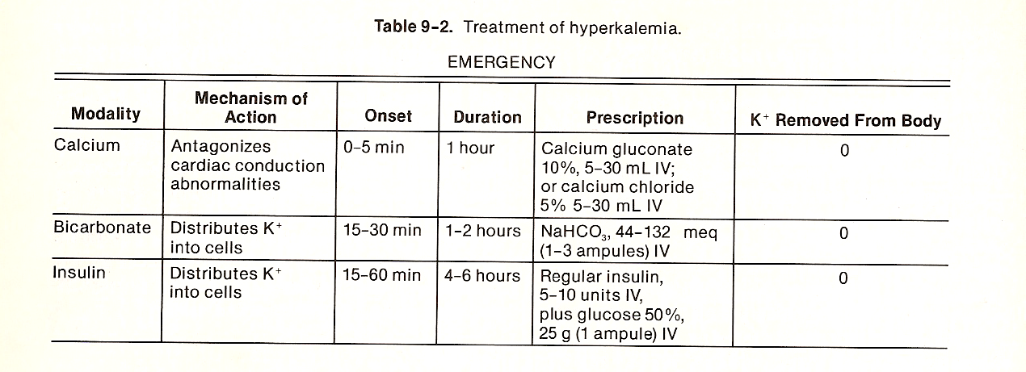

Slide 45
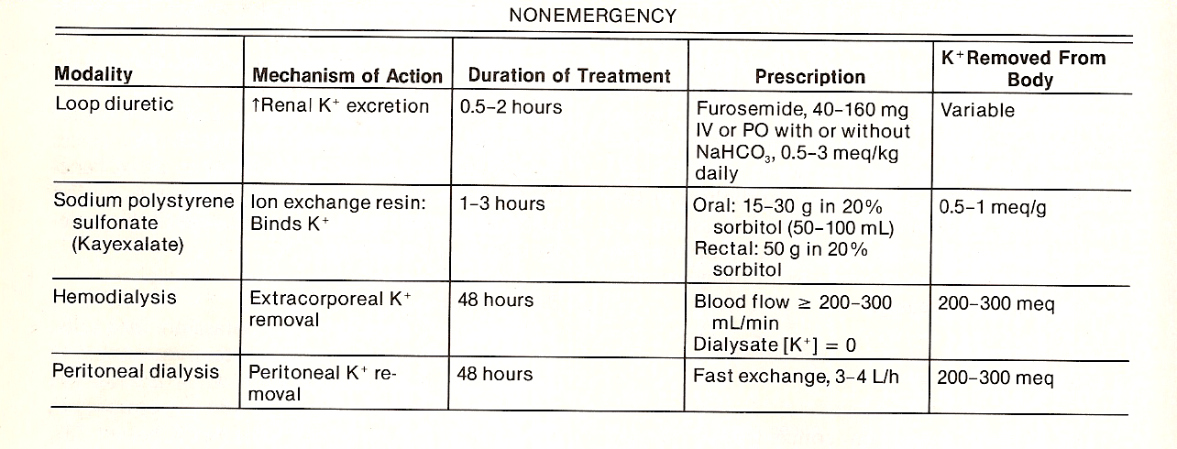

Slide 46
Patient 4
14 years old, male
Admitted to the hospital because of severe abdominal pain and vomiting for 6 hours
Routine electrolyts are unremarkable
Operated for acute appendicitis
Hypotension, tachycardia, muscle rigidity began following halothane and succinylcholine
Fever rose from 37.2° to 41.5°C
Skin was red and warm at the beginning, later it got cold and cyanosis occured

Slide 47
Patient 4 (continued)
K 7.7, Mg 4.2 mEq/l, Lactate 108 mg/dl (12 mEq/l)
Arterial blood gases
pH: 6.92, PCO2: 18 Bicarbonate: 4
What is your diagnosis?

Slide 48
Patient 4 (Interpretation)
Malign hypertermia (Theoretical information is important)
Hyperpotasemia due to potassium released by skeletal muscles
Hypermagnesemia and lactic acidosis present
What is your treatment?

Slide 49
Patient 4 (Treatment)
Stop anesthetic drug
Oxygen
Get patient cold
Dantrolene Na
Diuretic + Bicarbonate (for rhabdomylosis)

Slide 50
Patient 5
40 years old, male
On hemodialysis treatment for 1 year
July, lives in Amasya
Can not walk in hemodialysis day, came by chair
What is your first lab test?

Slide 51

Patient 5 (continued)
Serum K level

Slide 52
Blood transfusion in hyperpotasemic patient?
What dou you consider?

Slide 53
ANSWER
Less waiting time
While waiting, potassium shifts form intracellular to extracellular

Slide 54
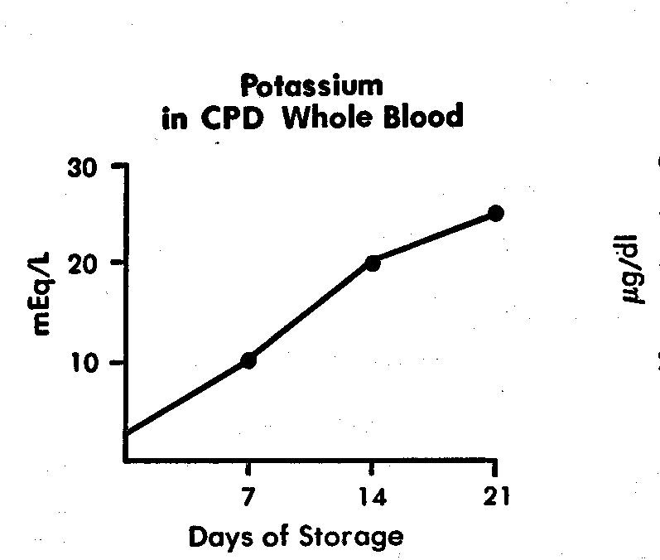

Slide 55
Patient 6
45 years old, male, diarrhea for 3 days (15-20 times/day)
Physical examination 90/60 mm Hg, cannot be measured while sitting, breathing 24/minute, increased depth, pulse 120/minute,
Turgor tonus decreased, dry mouth

Slide 56
Patient (continued)
Arterial blood gases
pH 7.26, PCO₂: 25 mm Hg, HCO₃: 11 mEq/l, PO₂: 93 mm Hg
Serum electrolytes
Na: 133 mEq/l, K 2.1 mEq/l, Cl 107 mEq/l, Total CO₂ 13 mmol/l, Anion gap 13 mEq/l, Total protein 8.5 gr/dl
What is your diagnosis?

Slide 57
Lab findings supporting hypovolemia
Hb, Htc increase
Total protein, albumin increase
BUN/creatinine ratio increase
Urine Na

Slide 58
Patient with acid-base metabolism disturbance
Arterial blood gases: Is internal consistency present? YES
Acidosis? Alkalosis? ACIDOSIS
Metabolic? Respiratory? METABOLIC
Adaptive changes expected? Simple? Mixed? Acute? Chronic? Acute on chronic?
Anion gap?
Other electrolyte disturbance or accompanying problem?
Expected acid-base disturbances

Slide 59
Adaptive changes expected?
The patient has metabolic acidosis
HCO₃: 11 mEq/l, PCO₂: 25 mm Hg
HCO₃ 13 decreased, PCO₂ 15 decreased

Slide 60
Adaptive changes
Each 1 mEq/l decrease of HCO3, 1.25 mm Hg decrease of PaCO2
May change up to 5 mm Hg or
PaCO2=(1.5x[HCO3]) + 8
May change up to 2 mm Hg
Required time: 12-24 hours
Ratio of the patient 13/15, compatible
or
25=(1.5x11) + 8 = 24.5, compatible

Slide 61
Adaptive changes expected? Simple? Mixed? Acute? Chronic? Acute on chronic?
Simple (Adaptive changes are compatible)
Acute (from history)

Slide 62
What is anion gap?
Anion gap 13 mmol/l
Normal value 10-14 mEq/l
Anion gap is normal in the patient

Slide 63
Normal anion gap acidosis
Bicarbonate loss
Gastrointestinal system (diarrhea)
Kidney (renal tubular acidosis)
How can we distinguish?

Slide 64
Urinary anion gap
([Na⁺] + [K⁺]) – ([HCO₃⁻])
Normal value +30-50 mmol/l
Negative value indicates urinary excretion of NH₄⁺ compensated by gastrointestinal bicarbonate loss

Slide 65
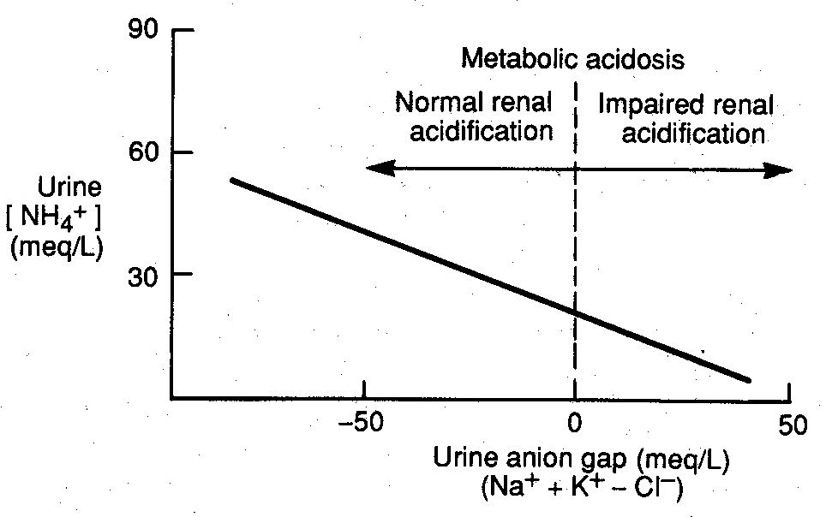

Slide 66
Other electrolyte disturbance or accompanying problem?
Hypopotasemia
Hypovolemia

Slide 67
Expected acid-base disturbances
Kidney failure Metabolic acidosis
COLungD Respiratory acidosis
Diarrhea Metabolic acidosis
Nasogastric aspiration Metabolic alkalosis
Biliary drainage Metabolic acidosis
Salycilate intoxication Metabolic acidosis
Respiratory alkalosis
Diuretics Metabolic acidosis
Metabolic alkalosis

Slide 68
Expected acid-base disturbances
Methanol Metabolic acidosis
Alcohol intoxication Metabolic acidosis
Ethylen glycol Metabolic acidosis
Liver failure Metabolic acidosis
Respiratory alkalosis
Diabetic ketoacidosis Metabolic acidosis
Sepsis Metabolic acidosis
Respiratory alkalosis
Hunger Metabolic acidosis

Slide 69
Expected acid-base disturbances
Cardiogenic shock Metabolic acidosis
Respiratory acidosis
Primary hyperaldosteronism Metabolic alkalosis
Intracranial events Respiratory alkalosis
Fever Respiratory alkalosis
Anxiety Respiratory alkalosis
Vomiting Metabolic alkalosis

Slide 70
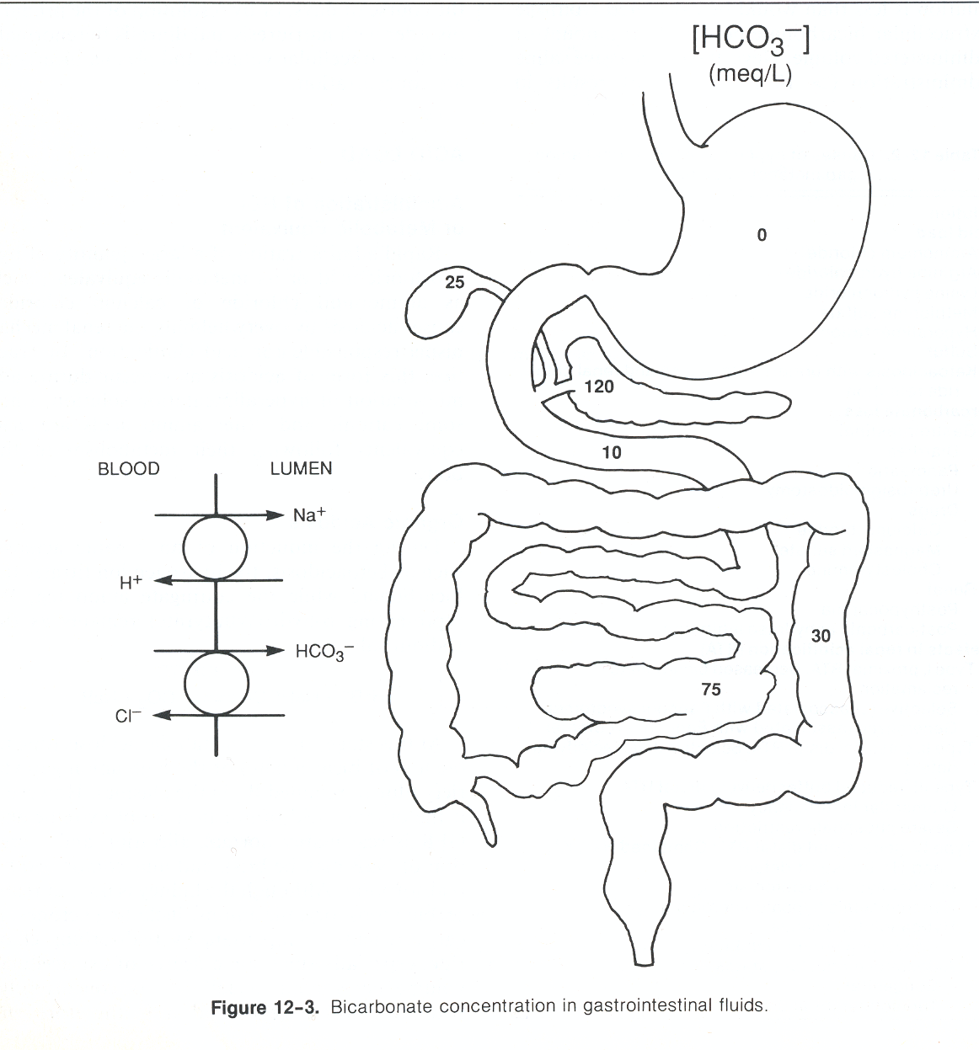

Slide 71
Metabolik acidosis
Loss of fluid rich in bicarbonate

Slide 72
Patient (again)
45 years old, male, diarrhea for 3 days (15-20 times/day)
Physical examination 90/60 mm Hg, cannot be measured while sitting, breathing 24/minute, increased depth, pulse 120/minute,
Turgor tonus decreased, dry mouth

Slide 73
Patient (again)
Arterial blood gases
pH 7.26, PCO₂: 25 mm Hg, HCO₃: 11 mEq/l, PO₂: 93 mm Hg
Serum electrolytes
Na: 133 mEq/l, K 2.1 mEq/l, Cl 107 mEq/l, Total CO₂ 13 mmol/l, Anion gap 13 mEq/l, Total protein 8.5 gr/dl
What is your diagnosis?

Slide 74
Patient (comment)
Metabolic acidosis due to diarrhea
Hypopotasemia
Hypovolemia

Slide 75
Patient (continued): Other problems expected
Hypopotasemia and Hypovolemia related problems

Slide 76
Patient (continued)
What is bicarbonate deficit?

Slide 77
Bicarbonate deficiency
0.5 x weight (kg) x (24 - [HCO3])
In severe acidosis or hypovolemia 0.5 coefficient may increase
Fluid electrolyte balance disturbances are dynamic periods
H is an electrolyte

Slide 78
Bicarbonate dosage
More than half of deficiency must not be given in 3-4 hours
Formula does not consist of new H production

Slide 79
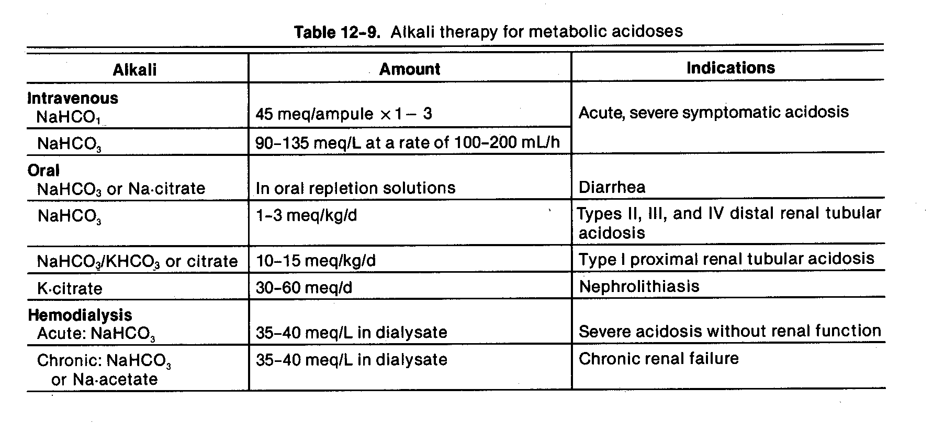

Slide 80
Side effects of bicarbonate treatment
Sodium bicarbonate

Slide 81
Side effects of bicarbonate treatment
Hypernatremia (ampul concentration 892 mEq/l)
Hypercapnia
HCO₃ + H »»» H₂CO₃ »»» CO₂ + H₂0
Hypopotasemia
Alkalosis, tetani

Slide 82
www.tekinakpolat.com

