Slide 1


RENAL TUBULAR DISEASES
Prof. Dr. Tekin AKPOLAT
Istinye University, School of Medicine
Liv Hospital-İSTANBUL
2025-2026
www.tekinakpolat.com

Slide 2
Plan
Basic information
Renal tubular diseases
Acute diseases
Chronic diseases
Treatment
Medicines and toxic nephropathy
Summary

Slide 3
Basic kidney functions (summary)
1.Circulation: sodium…
2.Metabolic balance: acid base…
3.Scavenger: urea…

Slide 4
URINE FORMATION
Renal blood flow
Glomerular filtration
Tubular reabsorption
Tubular secretion

Slide 5
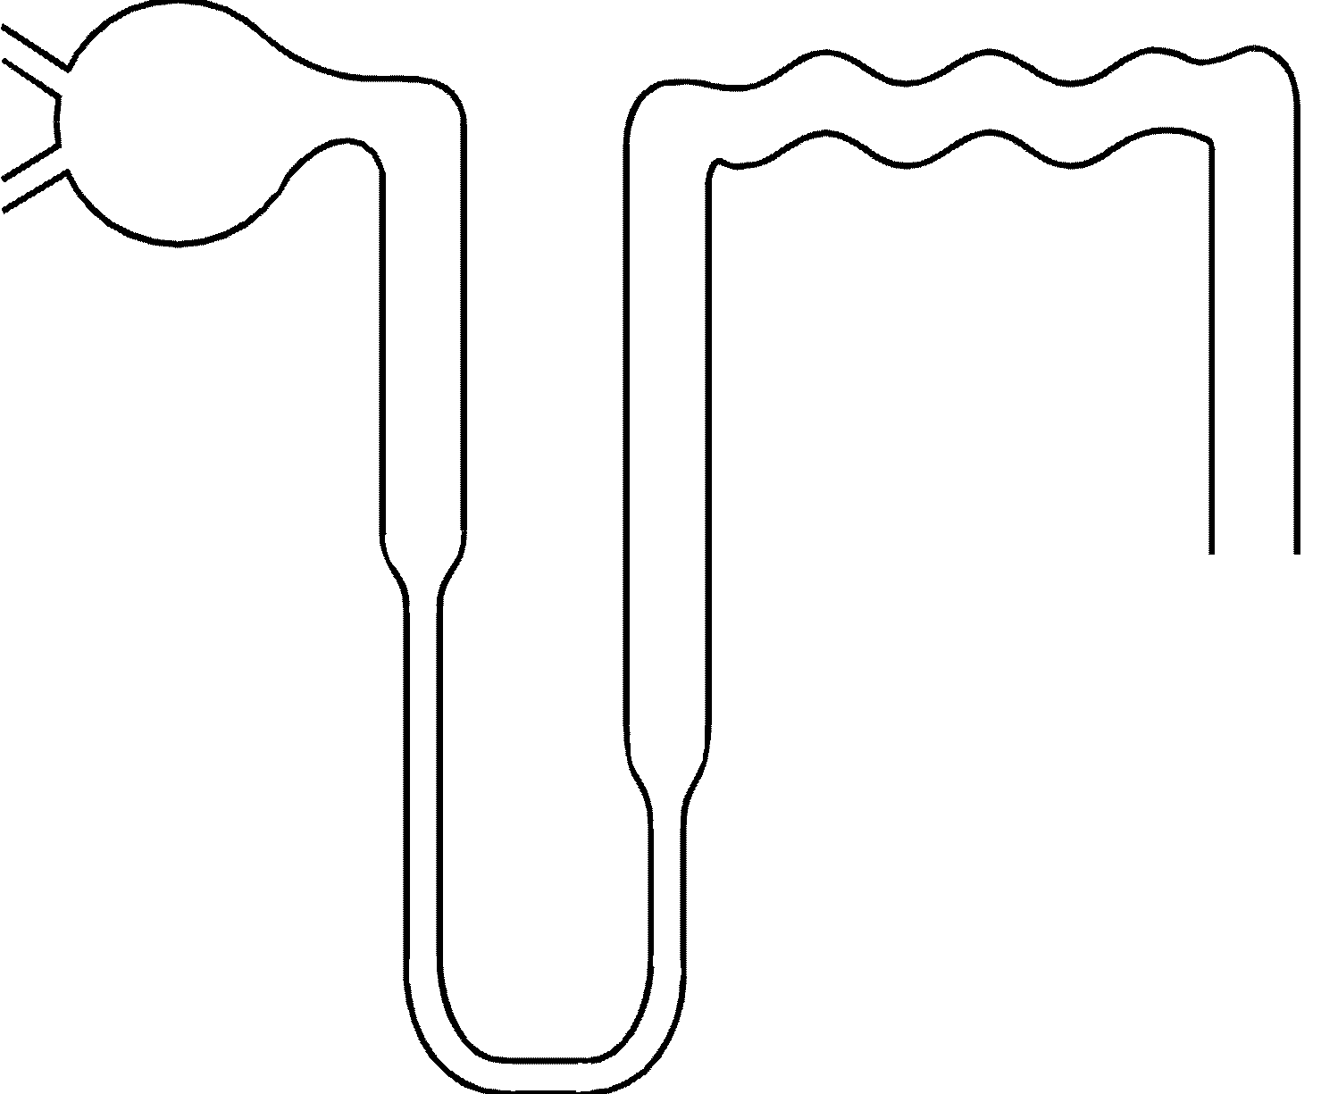
Proximal tubul
Glomerul
Distal tubul
Henle loop ascending
Collecting tubul
Henle loop descending

Slide 6
TUBUL FUNCTION
CORTEX
PROXIMAL REABSORPTION (amino acid,
TUBUL bicarbonate, glucose, phosphate,
protein, sodium, uric acid)
DISTAL Sodium reabsorption
K, H excretion
MEDULLA AND Urine concentration
PAPILLA Sodium reabsorption

Slide 7
KIDNEY DISEASES
Kidney diseases can be categorised into four groups structurally: vascular, glomerular, tubular and urine collecting systems.
Glomerular diseases are actually vascular disease because glomeruli are capillary loops
To understand tubular diseases we must know other diseases
In some circumstances vascular, glomerular and tubular are intertwined or other sites may be affected after initiation

Slide 8
VASCULAR DISEASES
We first think arterial or venous obstruction, thrombus, stenosis as vascular kidney disease
Renal arter stenosis due to atherosclerosis, renal vein thrombosis, renal arterial atheroembolisation and fibromuscular dysplasia are the most common renal vascular diseases

Slide 9
GLOMERULAR DISEASES
In the nephron, problem is mainly in the glomeruli. Progression of the disease damages tubuli later.
But in tubular diseases, problem is mainly in the tubuli. Progression of the disease damages glomeruli later.
There are different types of glomerulonephritis.

Slide 10
Plan
Basic information
Renal tubular diseases
Acute diseases
Chronic diseases
Treatment
Medicines and toxic nephropathy
Summary

Slide 11
RENAL TUBULAR DISEASES
TUBULOINTERSTITIAL DISEASE
TUBULOINTERSTITIAL NEPHRITIS (TIN)
TUBULOINTERSTITIAL NEPHROPATHY
Notes:
ŞEKİLLER İÇİN D3TUBULER KLASÖRÜNE BAK

Slide 12
TUBULAR DISEASES
Primary lesion is at the tubuli and interstitium
It affects glomeruli later, histologic lesion is glomerulosclerosis
Clinical and laboratory findings of glomerular involvement is decrease of GFR, proteinuria and hypertension

Slide 13
Signs and symptoms in tubular diseases 1
Tubular dysfunction inappropriate to GFR decrease
Tubular abnormalities
a. Decrease of maximum urine concentration ability (poliuria, nocturia)
b. Renal tubular acidosis (Hyperchloremic metabolic acidosis)
c. Partial or complete Fanconi syndrome
Phosphaturia Uricosuria
Bikarbonaturia Glucosuria
Aminoaciduria
d. Sodium loss
e. Hyperkalemia

Slide 14
Signs and symptoms in tubular diseases 2
Renal endocrine abnormalities
a.Hyporeninemic hypoaldosteronism (hyperkalemi, metabolic acidosis)
b.Calcitriol deficiency (renal osteodystrophia)
c.Erythropoietin deficiency (anemia)
Urine analysis
a.May be normal but usually consists of cellular elements
b.In general, proteinuria is moderate (<3.5g/day) and mainly low molecular tubular proteins such as lysozyme and beta2 microglobuline

Slide 15
Tubular proteinuria
In the urine, the presence of proteins having smaller molecular size (beta2 microglobuline, molecular weight 11.500 dalton) rather than albumin (molecular weight 69.000 dalton).
These proteins pass glomerular basal membrane easily and reabsorb from proximal tubuli.
Urine protein electrophoresis is needed for diagnosis.
Tubular proteinuria is generally less than 1.5 gram/day.

Slide 16
Glomerular Diseases
Primary lesion is at the glomeruli
It affects tubuli and interstitium later

Slide 17
GLOMERULAR DISEASES
1.Urinary abnormalities
2.Macroscopic hematuria
3.Nephrotic syndrome
4.Acute glomerulonephritis
5.Chronic glomerulonephritis
6.Rapidly progressive nephritis

Slide 18
TUBUL FUNCTION
CORTEX
PROXIMAL REABSORPTION (amino acid,
TUBUL bicarbonate, glucose, phosphate,
protein, sodium, uric acid)
DISTAL Sodium reabsorption
K, H excretion
MEDULLA AND Urine concentration
PAPILLA Sodium reabsorption

Slide 19
LOCALISATION FUNCTION ABNORMALITY OF LESION
CORTEX
PROXIMAL REDUCED REABSORPTION
TUBUL (amino acid, bicarbonate, glucose,
phosphate, protein, sodium, uric acid)
DISTAL Reduced sodium reabsorption
Reduced K, H excretion
MEDULLA AND Reduced urine concentration
PAPILLA Reduced sodium reabsorption

Slide 20
Plan
Basic information
Renal tubular diseases
Acute diseases
Chronic diseases
Treatment
Medicines and toxic nephropathy
Summary

Slide 21
ACUTE TIN
CHARACTERIZED BY SUDDEN IMPAIRMENT OF KIDNEY FUNCTION
EDEMA AND INFLAMMATORY MONUNUCLEAR CELL INFILTRATION IN THE INTERSTITIUM
NO FIBROSIS IN THE INTERSTITIUM
GLOMERULI AND VESSELS ARE NORMAL
TUBULAR INJURY MAY BE BUT TUBULAR ATROPHY IS ABSENT
IN GENERAL, BIOPSY IS NOT REQUIRED FOR DIAGNOSIS

Slide 22
Causes of Acute TIN 1
Medicines
Infections
Systemic infections: Brucellosis, cytomegalovirus infection, diphteria, infectious mononucleosis, leptospirosis, syphylis, streptococcal infections, toxoplasmosis, mycoplasma pneumonia, Legionnaires disease
Renal infections: Bacterial pyelonephritis, renal tuberculosis, fungal nephritis

Slide 23
Causes of Acute TIN 2
Systemic diseases
Metabolic disorders: Hyperuricemia, hypopotasemia, hypercalcemia, oxalat metabolism abnormalities
Heavy metals: Lead, Cadmium
Immunologic disases: SLE, sarcoidosis, acute rejection of transplanted kidney, necrotizing vasculitis
Hematopoietic diseases: Lymphoproliferative diseases, plasma cell dyscrasias
Idiopathic

Slide 24
Medicines causing acute TIN
Antibiotics
NSAIDs
Antiepileptics
Anticaogulants
Diuretics
Immunosuppressives
Others

Slide 25
ACUTE TIN
DOES NOT DEPEND ON DOSAGE
SEEN ONLY A MINORITY OF THE PATIENTS GOT MEDICINE
REPEATS WHEN MEDICINE IS GIVEN AGAIN
IT IS USUALLY WITH SYSTEMIC SYMPTOMS RELATED TO HYPERSENSITIVITY
ANTIBODIES TO MEDICINE CAN BE DETECTED IN BLOOD

Slide 26
TIN DUE TO DRUGS 1
HEMATURIA
PYURIA
PROTEINURIA (TUBULAR)
NSAID MAKES MASSIVE PROTEINURIA
EOSINOPHILURIA
SERUM IgE MAY INCREASE
COOMBS TEST MAY BE POSITIVE
KIDNEY SIZES ARE NORMAL BY ULTRASONOGRAPHY

Slide 27
TIN DUE TO DRUGS 2
DYSFUNCTION MAY CHANGE FROM MILD TUBULAR DYSFUNCTION TO ACUTE KIDNEY INJURY
MOST OF THEM NONOLIGURIC
OLIGURIC PERIOD MAY LAST A FEW DAYS
DIALYSIS SUPPORT MAY BE NEEDED

Slide 28
TIN DUE TO DRUGS 3
IN GENERAL, IMPROVES AFTER DISCONTINUATION
TREATMENT IS SYMPTOMATIC
IMMUNOSUPPRESSIVES MAY BE REQUIRED IN SEVERE KIDNEY FAILURE
RESPONSIBLE DRUG MUST NOT BE GIVEN ANY MORE (DRUG HISTORY IS IMPORTANT)

Slide 29
TIN DUE TO INFECTIONS
2 MECHANISMS PRESENT
Microorganism can invade kidney
Hypersensitivity without invasion or bacteraemia
First days after infection (rarely more than 10-12 days)
Glomerular lesions due to infections generally arises 2-3 weeks after

Slide 30
PYELONEPHRITIS
FEVER, SHIVERING, COSTOVERTEBRAL ANGLE TENDERNESS, DYSURIA
LEUKOCYTOSIS, PYURIA, BACTERIURIA, CYLENDIRS
POSITIVE URINE CULTURE
GFR USUALLY NORMAL
IN THE PRESENCE OF OBSTRUCTION, DM, LEPTOSPIROSIS, BRUCELLOSIS OR CANDIDIASIS GFR MAY DECREASE AND DISEASE CAN BE CHRONIC

Slide 31
CHRONIC TIN 1
IT IS PROGRESSIVE
INTERSTITIAL FIBROSIS, MONONUCLEAR CELL INFILTRATION, ATROPHY AND DEGENERATION IS PRESENT AT THE TUBULI
LATER SCLEROSIS, ATROPHY AND PERIGLOMERULAR FIBROSIS SEEN AT THE GLOMERULI
IT IS INSIDIOUS, IT IS HARD TO CATCH BEFORE GFR DECREASE AT EARLY PHASE

Slide 32
CHRONIC TIN 2
AT THE BEGINNING THERE ARE FINDINGS RELATED TO TUBULAR DYSFUNCTION
WITH PROGRESSION, GFR DECREASES, PROTEINURIA, EDEMA AND HYPERTENSION OCCURS
A COMMON CAUSE OF CKD: DRUGS AND TOXINS
ELIMINATION OF DRUG OR TOXIN MAY PREVENT CKD

Slide 33
Causes of Chronic TIN
Immunologic diseases
Medicines
Infections
Obstructive uropathy
Hematopoietic diseases
Heavy metals
Metabolic diseases
Granulomatous diseases
Other causes
Idiopathic

Slide 34
CHRONIC TIN DUE TO DRUGS
MOST COMMON CAUSE OF CHRONIC TIN
ANALGESICS MAY CAUSE PAPILLARY NECROSIS
IN GENERAL, KIDNEY FUNCTIONS IMPROVE AFTER DISCONTINUATION OF THE DRUG
IF IT INVOLVES MEDULLA, URINE CAN NOT BE CONCENTRATED, WE SEE POLIURIA, NOCTURIA
DISTAL TUBULI MAY BE INVOLVED

Slide 35
ANALGESIC NEPHROPATHY
PATIENTS USUALLY GOT MEDICINE MORE THAN 3 KG
FREQUENCY OF RENAL PELVIS CA RISK INCREASED (due to papillary necrosis, phenacetin)
MORE FREQUENT IN FEMALES
AT THE BEGINNING NO SYMPTOMS
PAPILLARY NECROSIS, OBSTRUCTION, UROSEPSIS, HYPERTENSION, PROTEINURIA MAY BE FIRST FINDING

Slide 36
COMMON EXTRARENAL FINDINGS IN ANALGESIC NEPHROPATHY
GASTRIC ULCER (ESPECIALLY ASPIRIN)
ANEMIA (DUE TO CHRONIC BLOOD LOSS)
NEUROPSYCHIATRIC SYMPTOMS
INCREASED DRUG, ALCOHOL, CIGARETS
EARLY AND DIFFUSE ARTERIOSCLEROSIS
BROWN SKIN PIGMENTATION

Slide 37
TIN: DIAGNOSTIC TESTS
Tubular proteins, enzymes and antigens are always popular in the diagnosis and follow up of tubular diseases

Slide 38
Plan
Basic information
Renal tubular diseases
Acute diseases
Chronic diseases
Treatment
Medicines and toxic nephropathy
Summary

Slide 39
TIN: TREATMENT
TREATMENT OF UNDERLYING DISEASE
SYMPTOMATIC TREATMENT (Fluid, sodium, alkali, oral phosphate, Vitamin D, potassium if required)
IF CKD DEVELOPS
CONSERVATIVE TREATMENT
DIALYSIS
RENAL TRANSPLANTATION

Slide 40
Plan
Basic information
Renal tubular diseases
Acute diseases
Chronic diseases
Treatment
Medicines and toxic nephropathy
Summary

Slide 41
MEDICINES AND TOXINS
AMINOGLYCOSIDES
RADIOGRAPHIC CONTRAST AGENTS
NON-STEROIDAL ANTIINFLAMMATORY MEDICINES
ANALGESIC NEPHROPATHY
VANCOMYCIN
AMPHOTERICIN B
ACYCLOVIR

Slide 42
Some nephrotoxic medicines/agents/states
Chemotherapy drugs: Cisplatin, methotrexate, mitramycin, cyclophosphamide, vincristine
Cyclosporine, tacrolimus
Lithium
Heavy metals
Gold
Radiation nephritis
Other substances: Ethylene glycol (anti freezing)
Colistin

Slide 43
TOXIC NEPHROPATHY
http://tekinakpolat.com/toksik-nefropati/

Slide 44
Plan
Basic information
Renal tubular diseases
Acute diseases
Chronic diseases
Treatment
Medicines and toxic nephropathy
Summary

Slide 45
SUMMARY
Tubular and glomerular diseases are the most common diseases seen in nephrology practice
In some states the distinction is difficult, because a disease beginning from one may affect the other or same disease may affect both
Mild signs in some tubular diseases makes the diagnosis difficult
Medicines are important agents

Slide 46
SUMMARY
Kidney is one of the most common organs affected from medicine and substance side effects
These side effects are variable, may be mild or may be chronic kidney disease requiring dialysis
Most of these side effects are preventable, hydration is important
Nowadays, there are many alternatives to nephrotoxic medicines
Avoidance of unnecessary medicines is the most important

Slide 47
SUMMARY
For diagnosis, first we must suspect
Theoretical information must be good
Treatment is mainly the underlying cause
In conservative treatment there may be differences from glomerular diseases: earlier treatment of acidosis, anemia, bone disease

