Slide 1


DISORDERS OF SODIUM AND WATER BALANCE 2
Prof. Dr. Tekin AKPOLAT
Liv Hospital-İSTANBUL
Istinye University School of Medicine
2025-2026
www.tekinakpolat.com

Slide 2
Patient 1
60 years, male, cardiac failure, pretibial ++ edema, Daily urine volume 2 liters
You want to decrease edema
What is your order?

Slide 3
ANSWER
The patient is hypervolemic
Hypervolemia must be treated
First let’s calculate losses: daily 2 liters urine + 1 liter insensible loss
If the patients takes daily 2.5 liters fluid, 0.5 liter fluid is lost daily
This treatment can be done until edema disappears

Slide 4
Patient 2
70 years old, female
Colon graphy is planned, she is not eating, drinking, laxative was given
What is your fluid order?

Slide 5
PURPOSES OF FLUID TREATMENT
Maintenance of fluid balance in an euvolemic patient
In patients having fluid imbalance present preventive measures (very important)
Correction of fluid imbalance

Slide 6
ANSWER
Dehydration must be prevented
Intravenous fluid if requires

Slide 7
PATIENT ORDERS
Before order, you should decide duration of the order

Slide 8
Patient 3
70 years old, female
Hospitalized for cataract surgery
Operation was planned for tomorrow
What is your fluid order for operation day?

Slide 9
ANSWER
Dehydration must be prevented
If required intravenous fluid

Slide 10
Patient 4
50 years old, female
New CKD diagnosis
Edema absent
Serum creatinine 12 mg/dl
In the hospital
What is your fluid order?

Slide 11
ANSWER
The patient may be dehydrated
May urinate after hydration
1 liter fluid may be given in 8 hours
If required intravenous fluid

Slide 12
Patient (continued)
Same patient
No urine after 8 hours
No edema
What is your new fluid order?

Slide 13
ANSWER
The patient may still be dehydrated
May urinate after hydration
1 liter fluid may be given in 8 hours
If required intravenous fluid

Slide 14
Patient (continued)
Same patient
No urine after 8 hours
Edema present
What is your new fluid order?

Slide 15
ANSWER
The patient is not dehydrated anymore
Hypervolemic
Hypervolemi may increase if more fluid given
Fluid order depends on urine amount

Slide 16
Patient (continued)
How do you provide fluid balance?

Slide 17
ANSWER
Dialysis

Slide 18
Same patient (continued but conditions different)
Same patient
1 liter urine, after second 8 hours
No edema
What is your new fluid order?

Slide 19
ANSWER
The patient responded to hydration
May urinate with hydration
Additional 1 liter fluid may be given in 8 hours
May be given depending on urine amount
If required intravenous fluid

Slide 20
Patient 5
60 years old female
Computerized brain tomography was planned
Contrast agent will be used
What is your fluid order?

Slide 21
ANSWER
Dehydration must be prevented
Contrast nephropathy risk
Drink plenty of water
Minimum 3 liters/day unless contraindicated
Intravenous fluid if requires

Slide 22
Patient 6
45 years old male
Cirrhosis and diffuse ascite
Hospitalized for ascite treatment
What is your fluid order?

Slide 23
ANSWER
The patient is hypervolemic
Hypervolemia must be treated
First let us calculate daily losses: Amount of urine + 1 litre insensible loss
Let urine amount be 1 litre/day
If intake is 2 liters, balance does not change
If intake is 1.5 liters, fluid loss is 0.5 liter/day
Same treatment until ascite disappears
Urgent treatment is not needed
Weight measurement is the most objective follow up parameter

Slide 24
Patient 7
72 years old, female
She was admitted to the emergency for dizziness and weakness
Positive findings in her history:
Hypertension
Diuretics
Less salt diet (she says compliant)
Diarrhea for 3 days

Slide 25
Patient (continued)
Physical examination
Sleepiness, absence of focal neurologic deficit
60 kg
Supine BP 96/56 mm Hg
Pulse 110/min
Neck veins flat
Decreased skin turgor tonus

Slide 26
Patient (continued)
Laboratory findings
Blood Na 106 mmol/l, K 3.5 mmol/l, Bicarbonate 22 mmol/l, BUN 46 mg/dl, Creatinine 1.4 mg/dl
Serum osmolality: 232 mOsm/kg
Urine osmolality: 650 mOsm/kg

Slide 27
PROBLEM
Hyponatremia: Blood Na 106 mmol/l
First hyponatremia differential diagnosis

Slide 28
Hyponatremia: Differential diagnosis
Pseudohyponatremia: Should be discarded
Translocational: Should be discarded
Hypoosmolar hyponatremia
Hypovolemic
Euvolemic
Hypervolemic

Slide 29
Pseudohyponatremia
Related to measurement method
Pseudohyponatremia occurs when the solid phase of plasma (usually 6-8%) is increased
Flame photometry method measures sodium in wholw plasma (solid + liquid)
Each 4.6 g/l (460 mg/dl) increase of plasma lipids decreases serum sodium by 1 mmol/l
Each 10 g/dl increase of plasma proteins decreases serum sodium by 1 mmol/l

Slide 30
Translocational hyponatremia
Some substances increasing plasma osmolarity causes hyponatremia by movement of water from intracellular to extracellular compartment
Which substances?

Slide 31
Which substances?
Substances cannot enter intracellular or having problems for intracellular movement
Glucose: Each 100 mg/dl increase of plasma glucose decreases serum sodium by 1.6 mmol/l
Mannitol
Glycine (Used in prostate and endometrial surgery)
Maltose

Slide 32
Substances can freely enter cell
Urea
Ethanol
Ethylen glycol
Isopropyl alcohol
Methanol
But they do not affect serum sodium despite increase of osmolarity
These substances can freely enter cell and do not lead water movements

Slide 33
Hypoosmolar hyponatremia: Causes
Hypovolemic: This patient
Euvolemic
Hypervolemic

Slide 34
Hyponatremia: Differential diagnosis
Pseudohyponatremia: Discarded
Translocational: Discarded
Hypoosmolar hyponatremia
Hypovolemic: This patient
Euvolemic
Hypervolemic

Slide 35
Hypoosmolar hyponatremia
Hypovolemic (this patient, diarrhea and diuretic treatment)
Euvolemic
Hypervolemic

Slide 36
Treatment
Underlying cause
Sodium level determinant
Depends on symptoms
Development of hyponatremia rate important
Daily improvement must not exceed 10 (15?) mmol/l
Hourly improvement must not exceed 1-1.5 mmol/l

Slide 37
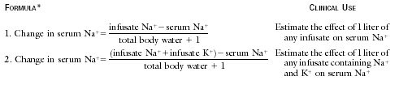
Adrogue-Madias equation

Slide 38
Coefficient for total body water
Children 0.6
Man 0.6
Woman 0.5
Older man 0.5
Older woman 0.45

Slide 39
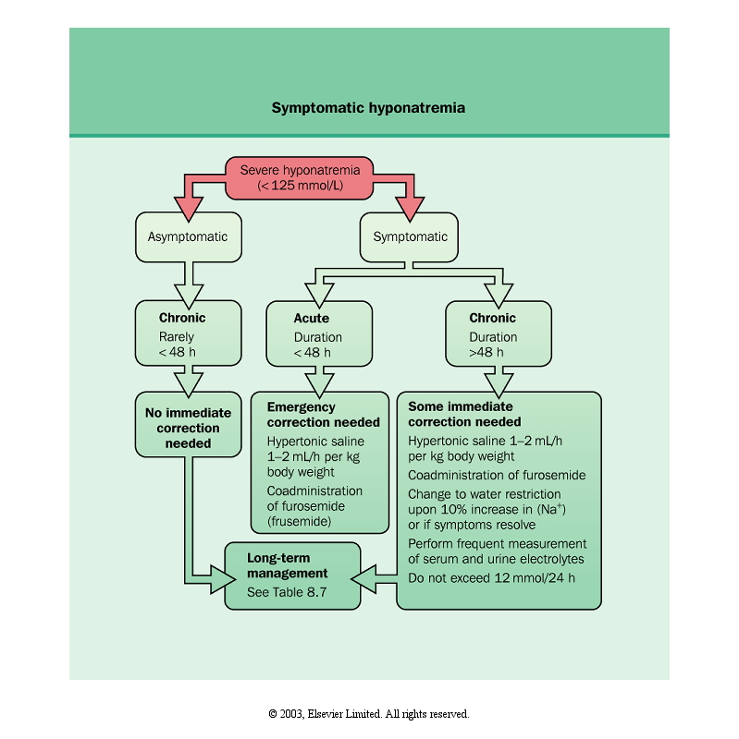

Slide 40
Patient 8 (difference only K)
72 years old, female
She was admitted to the emergency for dizziness and weakness
Positive findings in her history:
Hypertension
Diuretics
Less salt diet (she says compliant)
Diarrhea for 3 days

Slide 41
Patient 8 (continued)
Physical examination
Sleepiness, absence of focal neurologic deficit
60 kg
Supine BP 96/56 mm Hg
Pulse 110/min
Neck veins flat
Decreased skin turgor tonus

Slide 42
Patient (continued)
Laboratory findings
Blood Na 106 mmol/l, K 2.2 mmol/l, Bicarbonate 22 mmol/l, BUN 46 mg/dl, Creatinine 1.4 mg/dl
Serum osmolality: 232 mOsm/kg
Urine osmolality: 650 mOsm/kg

Slide 43
ANSWER

Slide 44
Adrogue-Madias equation Formula with potassium

Slide 45
What happens if we give 1 liter %0.9 NaCl+ 30 mmol KCl in one hour?
Total body water 27 liters
Δ Plasma Na : (154+30)-106 27+1
Δ Plasma Na : 2.8
Plasma Na: 106 + 2.8 = 108.8

Slide 46
Let us treat patient for 2 hours, at the end
NEW VALUES
Blood pressure 128/72 mm Hg
Na 112 mmol/l
K 3 mmol/l
Hypovolemia improved
How is treatment now?

Slide 47
Since hypovolemia improved, nonosmotic ADH stimulation disappears
Now urine can be diluted (ADH concentrates urine)
What happens if we give 1 liter %0.45 NaCl+ 30 mmol KCl?

Slide 48
What happens if we give 1 liter %0.45 NaCl+ 30 mmol KCl in one hour?
Total body water 27 liters
Δ Plasma Na : (77+30)-112 27+1
Δ Plasma Na : - 0.2
Plasma Na: 112 – 0.2: 111.8 yani düşer

Slide 49
But kidneys begin to excrete water
If urine is more diluted than Na + K concentration in given solution (77+30) will cause Na + K retention in the body
Both hyponatremia and hypopotasemia will continue to improve
In addition, given potassium will lead to sodium to cell

Slide 50
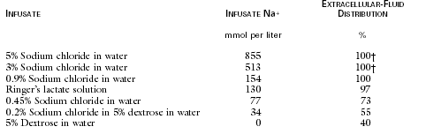
Sodium content of solutions and extracellular/intracellular

Slide 51
What is osmolar gap?

Slide 52
Osmolar gap
Measured osmolarity – Expected osmolarity
Expected osmolarity:
2 x [Na] + [Glukoz](mg/dl) + [BUN] (mg/dl)
18 2.8
Normally, there is 10 mOsm/kg

Slide 53
When osmolar gap increases?

Slide 54
When osmolar gap increases?
One substance
Increasing osmolarity
But not in this formula

Slide 55
Translocational hyponatremia
Some substances increasing plasma osmolarity causes hyponatremia by movement of water from intracellular to extracellular compartment
Which substances?

Slide 56
Which substances?
Substances cannot enter intracellular or having problems for intracellular movement
Glucose: Each 100 mg/dl increase of plasma glucose decreases serum sodium by 1.6 mmol/l
Mannitol
Glycine (Used in prostate and endometrial surgery)
Maltose

Slide 57
Substances can freely enter cell
Urea
Ethanol
Ethylen glycol
Isopropyl alcohol
Methanol
Only these substances can increase osmolar gap

Slide 58
Hyponatremia: Differential diagnosis
Pseudohyponatremia
Translocational:
Hypoosmolar hyponatremia
Hypovolemic
Euvolemic
Hypervolemic

Slide 59
Pseudohyponatremia
Related to measurement method
Pseudohyponatremia occurs when the solid phase of plasma (usually 6-8%) is increased
Flame photometry method measures sodium in wholw plasma (solid + liquid)
Each 4.6 g/l (460 mg/dl) increase of plasma lipids decreases serum sodium by 1 mmol/l
Each 10 g/dl increase of plasma proteins decreases serum sodium by 1 mmol/l

Slide 60
Translocational hyponatremia
Some substances increasing plasma osmolarity causes hyponatremia by movement of water from intracellular to extracellular compartment
Which substances?

Slide 61
Which substances?
Substances cannot enter intracellular or having problems for intracellular movement
Glucose: Each 100 mg/dl increase of plasma glucose decreases serum sodium by 1.6 mmol/l
Mannitol
Glycine (Used in prostate and endometrial surgery)
Maltose

Slide 62
Substances can freely enter cell
Urea
Ethanol
Ethylen glycol
Isopropyl alcohol
Methanol
But they do not affect serum sodium despite increase of osmolarity
These substances can freely enter cell and do not lead water movements

Slide 63
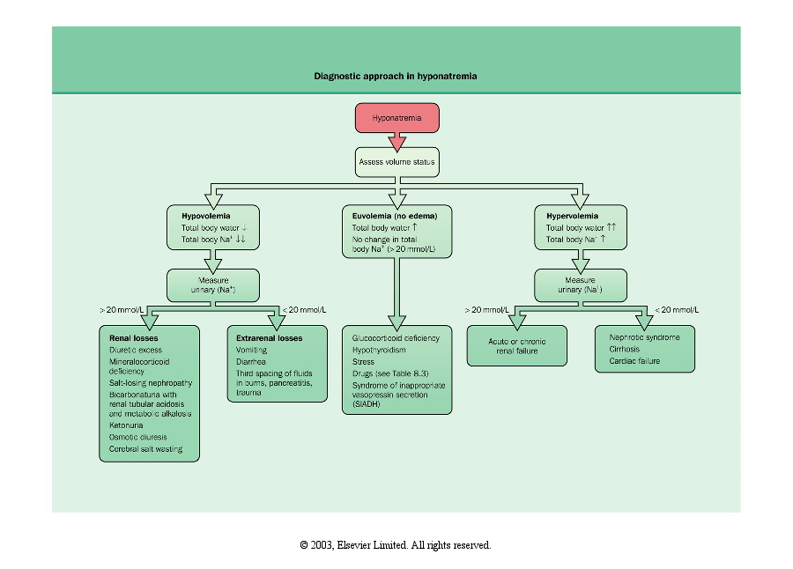

Slide 65
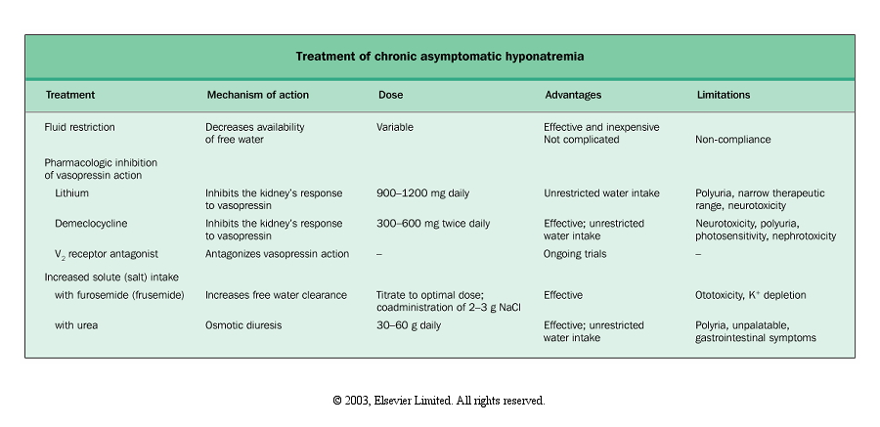

Slide 66
Adrogue-Madias equation Formula with potassium

Slide 67
Patient 9
58 years, male, small cell lung Ca
He was admitted to the hospital for sleepiness and confusion
Euvolemic and 60 kg
Serum Na 108 mmol/l, K 3.9 mmol/l, creatinine 0.5 mg/dl, BUN 5 mg/dl
Serum osmolality 220 mOsm/kg
Urine osmolality 600 mOsm/kg
What else do you want to know?

Slide 68
ANSWER
Theoretical knowledge is important
Small cell lung Ca may lead to inappropriate ADH syndrome

Slide 69
What is your treatment plan?
Fluid retention is the cause of hyponatremia in inappropriate ADH syndrome but we do not see edema

Slide 70
What is your treatment plan? (1)
Fluid restriction
% 3 NaCl + furosemide
Total body water 36 liters
According to the formula, 1 liter % 3 NaCl serum increase serum Na by 10.9 mmol/l
No more than 5 mmol/lt in 12 hours
460 ml is enough for 5 mmol/lt increase
460/12: 38 ml/hours

Slide 71
What is your treatment plan? (2)
12 hours after Na 114
Patient mild lethargic, but better
% 3 NaCl STOPPED, Fluid restriction continues
Long term treatment planned: Fluid restriction, Vasopressin Receptor Antagonists (Tolvaptan) if required

Slide 72
Patient 10
76 years, male
Admitted for dizziness, dry mucosa, decrease at skin turgor tonus, fever, tachypnea
BP 142/82, orthostatic hypotension absent
Patient 68 kg
Serum Na 168 mmol/l
What is your diagnosis?

Slide 73
ANSWER
First fluid balance

Slide 74
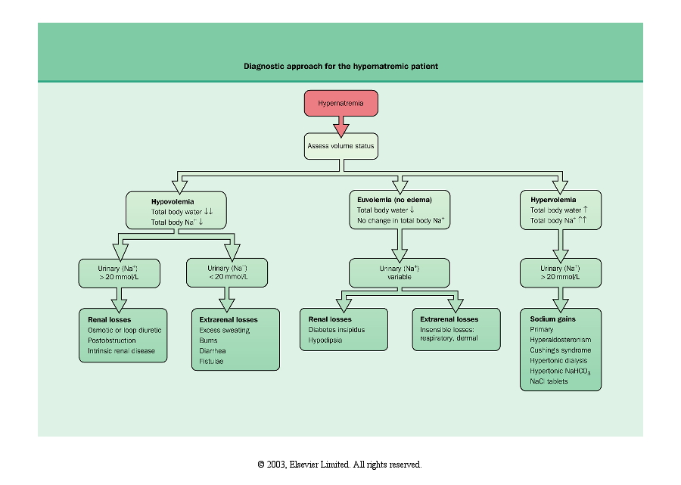

Slide 75
Hypernatremia causes

Slide 76
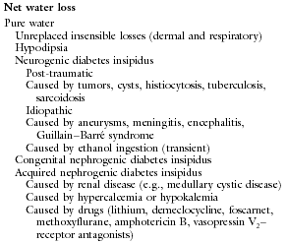

Slide 77
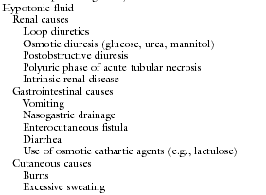

Slide 78
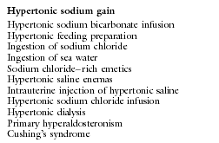

Slide 79
What is your treatment plan?

Slide 80
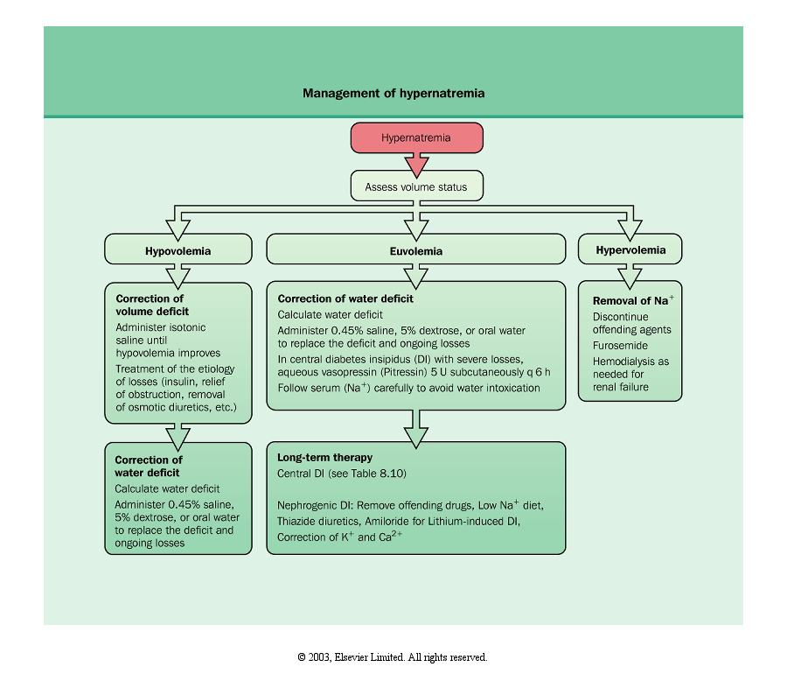

Slide 81
Adrogue-Madias equation

Slide 82
What is your treatment plan?
Total body water 34 liters
1 liter % 5 Dx decreases serum Na by 4.8 mmol/l
Target is decrease 10 mmol/l in 24 hours
2.1 liters % 5 Dx is enough
Patientsdaily fluid loss is about 1.5 liters
Therefore, Daily fluid amount must be 2.1 + 1.5 liters
3.6/24: 0.150 liter/hour
Blood sugar must be monitored closely
Patient must be followed every 6-8 hours

Slide 83
Water deficit
Total body water X Serum Na – 140
140
In this case 34 X (28/140) = 7 liters
2.1 liters % 5 Dx decreases serum Na by 10 mmol/l
To decrease 28 mmol/l required water amount
2.1 X 2.8 = 5.9 liters

Slide 84
INTERPRETATION
Values found by water deficit and Adrogue-Madias formulas are different
Movement direction is more important

Slide 85
Patient 11
45 years male
He was admitted to the emergency for loss of consciousness
Blood pressure 230/140 mm Hg
No venous fullness and edema
Intracranial bleeding was diagnosed and mannitol was given

Slide 86
Plasma values
Na 122 mEq/l
K 4 mEq/l
Cl 87 mEq/l
Bicarbonate 24 mmol/l
Glucose 109 mg/dl
BUN 13 mg/dl
Creatinine 1.1 mg/dl
Posm 298 mOsm/kg

Slide 87
Urine values
Na 49 mEq/l
K 34 mEq/l
Uosm 709 mOsm/kg
What is your diagnosis?

Slide 88
ANSWER
Theoretical knowledge is important
First fluid balance
Before what Mannitol does
Translocational hyponatremia

Slide 89
Translocational hyponatremia
Some substances increasing plasma osmolarity causes hyponatremia by movement of water from intracellular to extracellular compartment
Which substances?

Slide 90
Which substances?
Substances cannot enter intracellular or having problems for intracellular movement
Glucose: Each 100 mg/dl increase of plasma glucose decreases serum sodium by 1.6 mmol/l
Mannitol: Cause in this patient
Glycine (Used in prostate and endometrial surgery)
Maltose

Slide 91
Treatment plan?

Slide 92
Treatment plan
No treatment
Mannitol is necessary and primary
Plasma tonicity did not change much
Pay attention to mannitol related hypovolemia and NaCl loss

Slide 93
www.tekinakpolat.com

