Slide 1


KIDNEY FUNCTION TESTS
Prof. Dr. Tekin AKPOLAT
Liv Hospital-İSTANBUL
Istinye University, School of Medicine
2025-2026
www.tekinakpolat.com

Slide 2
http://tekinakpolat.com/pratik-nefroloji/

Slide 3
At the end of this lecture
YOU WILL LEARN
Basic renal functions
Glomerular filtration rate (GFR), creatinine clearence, plasma creatinine
Common problems in practice
Which test for what
The difference between kidney function tests and diagnostic methods
Other diagnostic methods

Slide 4
Tests I will mention in details
Blood creatinine
Creatinine clearence
BUN-Urea
Urine pH
Urine density
Urine protein
Urine glucose

Slide 5
Plan
Introduction
The difference between kidney function tests and diagnostic methods
How we measure each function
Glomerular filtration rate
Blood tests
Urine analysis
Other diagnostic methods

Slide 6
Basic kidney functions (1)
1.MAINTENANCE OF BODY FLUID AND ELECTROLYTE BALANCE: Water, sodium, potassium, hydrogen, bicarbonate, calcium, phosphorus, magnesium….
2.EXCRETION OF METABOLIC WASTE PRODUCTS: Urea, uric acid, creatinine
3.EXCRETION AND DETOXIFICATION OF MEDICINES, TOXINS AND METABOLITES

Slide 7
Basic kidney functions (2)
4.REGULATION OF EXTRACELLULAR FLUID VOLUME AND HORMONAL REGULATION OF BLOOD PRESSURE
Renin-angiotensin system
Renal prostaglandins
Renal kallikrein-kinin system
5.HORMONE PRODUCTION AND CONTRIBUTION TO METABOLISM: Erythropoietin, Vitamin D...

Slide 8
Basic kidney functions (3)
6.DEGRADATION OF PEPTIDE HORMONES: Insulin, glucagon, parathormone, calcitonin, growth hormone...
7.DEGRADATION OF LOW MOLECULAR WEIGHT PROTEINS: Light chains, beta₂-microglobulin...
8.METABOLIC EFFECT: Gluconeogenesis, lipid metabolism...

Slide 9
Basic kidney functions (summary)
1.Circulation: sodium…
2.Metabolic balance: acid base…
3.Scavenger: urea…

Slide 10
URINE FORMATION
Renal blood flow
Glomerular filtration
Tubular reabsorption
Tubular secretion

Slide 11
TUBUL FUNCTION
CORTEX
PROXIMAL REABSORPTION (amino acid,
TUBUL bicarbonate, glucose, phosphate,
protein, sodium, uric acid)
DISTAL Sodium reabsorption
K, H excretion
MEDULLA AND Urine concentration
PAPILLA Sodium reabsorption

Slide 12
LOCALISATION FUNCTION ABNORMALITY
OF LESION
CORTEX
PROXIMAL REDUCED REABSORPTION
TUBUL (amino acid, bicarbonate, glucose,
phosphate, protein, sodium, uric acid)
DISTAL Reduced sodium reabsorption
Reduced K, H excretion
MEDULLA AND Reduced urine concentration
PAPILLA Reduced sodium reabsorption

Slide 13
The difference between kidney function tests and diagnostic methods
We understand which functions of kidneys are deteriorated by kidney function tests
We try to understand the cause of kidney damage and dysfunction by diagnostic tests

Slide 14
Functions measured in practice
Glomerular filtration
Urinary acidification ability
Urinary concentration ability
Reabsorption function
Acid-base balance
Are tubular regulations adequate

Slide 15
Functions measured in practice
Glomerular filtration: Creatinin clearence…
Urinary acidification ability: Urine pH…
Urinary concentration ability: Urine dansity…
Reabsorption function: Proteinuria, glucosuria
Acid-base balance: Blood tests, anion gap, blood gases…
Are tubular regulations adequate: Blood and urine tests

Slide 16
Clearence
Removal of a substance from the blood, for example,
by renal excretion,
Expressed in terms of the volume flow of arterial blood
plasma that would contain the amount of substance
removed per unit of time; measured in mL/min.
Volume/Time, liter/day,
Normal values are commonly expressed per 1.73 m²
body surface area.
Notes:
https://medical-dictionary.thefreedictionary.com/clearance

Slide 17
GLOMERULAR FILTRATION
ABOUT 18-20% (FILTRATION FRACTION) OF BLOOD FLOW IS FILTRATED TO GLOMERULI
MAYBE THE MOST IMPORTANT KIDNEY FUNCTION
FREQUENT UNIT ml/min
NORMAL VALUE 70-145 ml/min/1.73 m²
DECREASES BY AGE
CLEARENCE FORMULAS USED IN DAILY PRACTICE

Slide 18
Creatinine clearence (ml/minute)
Urine creatinine (mg/dl) X Daily urine volüme (ml)
Serum creatinine (mg/dl) X 1440
By 24 hours urine collection

Slide 19
Why creatinine?
Best substance reflecting GFR in practice

Slide 20
Serum creatinine level
Important in the diagnosis but should be considered carefully
It can be inadequate alone in the follow up
Best substance reflecting GFR in practice

Slide 21
Measurement of GFR
(In practice)
BUN
Serum creatinine
There are factors affecting BUN and creatinine

Slide 22
Factors increasing plasma creatinine level
Increased muscle mass
Acute muscle injury
Meal consisting of excess meat
Cimetidine
Triamterene, Spironolactone, Amiloride
Probenecid
Trimethoprim
Other medicines (Barbiturates, cephalosporins, ascorbik acid)
Piruvic acid
Ketones (Diabetic ketoacidosis, alcohol poisoning)

Slide 23
Factors decreasing plasma creatinine level
Decreased muscle mass (elderly, atrophy, malnutrition, children)
Pregnancy
Inapproppriate ADH syndrome
Massive blood transfusion
Sepsis
Liver disease
Fluid overload

Slide 24
Creatinine clearence formulas
By 24 hours urine collection
Only with serum creatinine
Cockroft-Gault
MDRD
CKD-EPI
Other

Slide 25
Creatinine clearence (ml/minute)
Urine creatinine (mg/dl) X Daily urine volüme (ml)
Serum creatinine (mg/dl) X 1440
By 24 hours urine collection

Slide 26
Creatinine clearence (ml/minute)
(140-Age)(ideal weight)
Serum creatinine (mg/dl) X 72
Only with serum creatinine
(Cockcroft-Gault formula)

Slide 27
Values obtained by this formula must be decreased by 15% in woman, 20-40% in plegic patients
This formula is valid in stable kidney functions
Cannot be used in conditions which kidney functions changing rapidly such as development or recovery phases of acute kidney injury; 24 hours urine must be collected in these patients
GFR must be accepted as <10 ml/min in oliguric patients

Slide 28
MDRD
GFD= 186 X ([Scr] ^{-1.154}) X ([Age] ^{-0.203}) X (0.742 if female)
GFR: mg/ml/1.73 m²
[Scr]: serum creatinine level, mg/dl
Note: Must be multiplied by 1.21 in Blacks

Slide 29
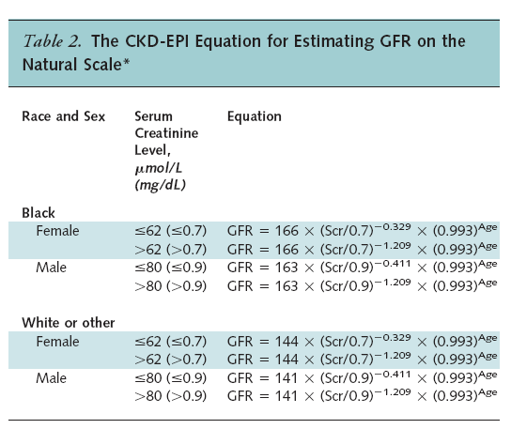
Notes:
CKD-EPI Chronic Kidney Disease Epidemiology Collaboration; GFR glomerular
filtration rate.
* Expressed for specified race, sex, and serum creatinine level. To convert GFR
from mL/min per 1.73 m2 to mL/s per 1.73 m2, multiply by 0.0167. We derived
equation coefficients from pooled development and internal validation data sets.
The CKD-EPI equation, expressed as a single equation, is GFR 141
min(Scr/, 1) max(Scr/, 1)1.209 0.993Age 1.018 [if female] 1.159 [if
black], where Scr is serum creatinine, is 0.7 for females and 0.9 for males, is
0.329 for females and 0.411 for males, min indicates the minimum of Scr/ or
1, and max indicates the maximum of Scr/ or 1. In this table, the multiplication
factors for race and sex are incorporated into the intercept, which results in different
intercepts for age and sex combinations.

Slide 30
CKD-EPI formula
GFD = 141 × min (S_{cr} /κ, 1)^{α} × max(S_{cr} /κ, 1)^{-1.209} × 0.993^{Yaş} × 1.018 [if female] × 1.159 [in Blacks]
GFD: ml/min/1.73 m² [Scr]: serum creatinine level, mg/dl
κ: Female 0.7, Male 0.9
α: Female -0.329, Mail -0.411
Min: S_{cr} /κ minimum value or 1
Max: S_{cr} /κ maximum value or 1

Slide 31
GFR Calculation
Qx calculator app (both android and apple)
http://www.nephron.com/

Slide 32
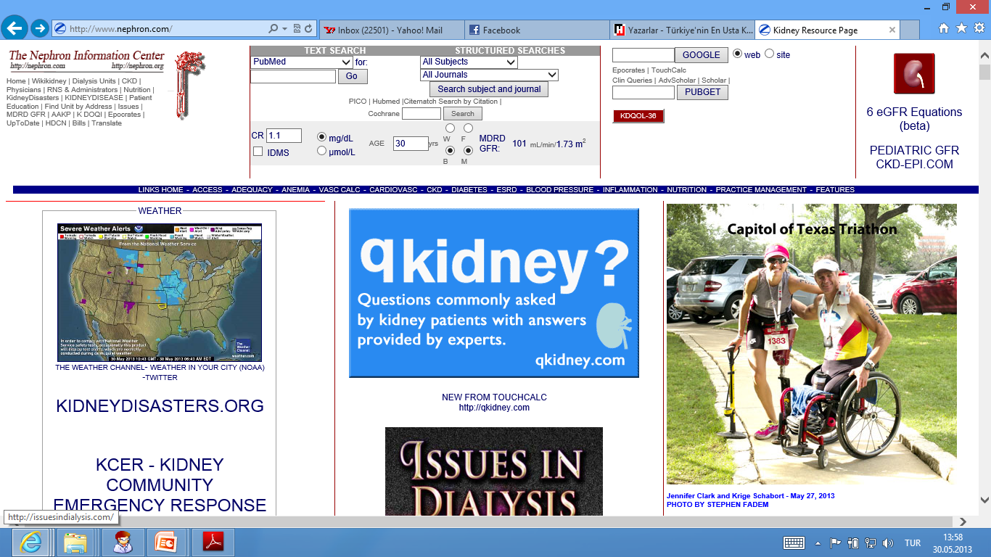

Slide 33
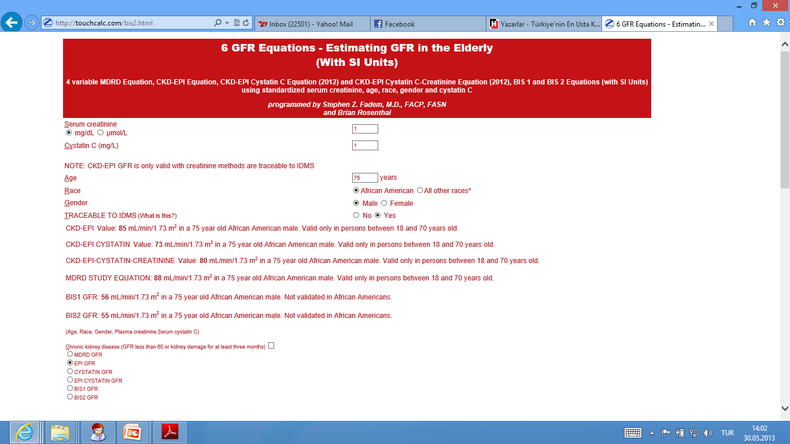

Slide 34
Adjustment for body surface area
One patient, GFR 70 ml/min and body surface area 1.5 m²
70 ml/min x 1.73 m² = 80.7 ml/minute/1.73 m²
1.5 m²
Body surface area adjustment may be required in huge or small patients

Slide 35
Conditions creatinine based formulas can not be used
Extreme ages, extreme body size
Severe malnutrion
Skeletal muscle diseases, Paraplegia or quadriplegia
Vegetarian diet
Rapidly changing kidney functions (AKI)
Other factors affecting serum creatinine

Slide 36
Practice of creatinine clearence
http://tekinakpolat.com/kreatinin-klirensi-pratigi/

Slide 37
Formulas with cystatin C
Only cystatin C
Cystatin C + Creatinine

Slide 38
Importance of creatinine clearence
Detection of kidney failure severity
Adjustment of medicine dosages
Initiation time of dialysis
Evaluation of treatment response

Slide 39
BUN (blood urea nitrogen)
BUN is also a substance reflecting GFR like creatinine
Its production and excretion depend on many factors, therefore, it is less sensitive

Slide 40
Factors increasing BUN
Kidney failure
Decreased urine flow
Dehydration
High protein diet
Gastrointestinal bleeding
Catabolic states
Medicines: Steroids, tetracyclin

Slide 41
Factors decreasing BUN
Low protein diet
Liver disease
Hunger
Anabolic states
Poliuria
Pregnancy
Inapproppriate ADH syndrome

Slide 42
Distinction between urea and BUN
This is one of the problems leading to confusion in nephrology practice.
Urea is molecule having a weight of 60 daltons. BUN is the nitrogen in the urea.
NH₂−−C−−NH₂
║
O

Slide 43
It can be understood that 28 of 60 daltons is nitrogen, therefore, urea level is 2.14 (60/28) times of BUN
BUN 10-20 mg/dl
Urea 20-40 or 20-50 mg/dl

Slide 44
Functions measured in practice
Glomerular filtration: Creatinin clearence…
Urinary acidification ability: Urine pH…
Urinary concentration ability: Urine dansity…
Reabsorption function: Proteinuria, glucosuria
Acid-base balance: Blood tests, anion gap, blood gases…
Are tubular regulations adequte: Blood and urine tests

Slide 45
Urine tests
pH
Density
Protein
Glucose
Microscopy
Blood, nitrite, urobilinogen, bilirubin, ketone

Slide 46
Urine electrolytes
Sodium
Potassium
Phosphorus
Calcium
Chloride

Slide 47
URINE pH
Simple test for function of urinary acidification
In normal, it is between 4 and 8
A pH of 5 shows acidification ability is good
Must be interpreted with blood pH
Can be measured by dipstick or pHmeter

Slide 48
ACID URINE
High protein diet, metabolic acidosis, fever, acute respiratory acidosis, water deprivation, potassium deficiency, gout, methanol intoxication, medicines

Slide 49
ALKALINE URINE
Waited urine, vegetarian diet, urease positive microorganism, acute respiratory alkalosis, metabolic alkalosis without potassium deficiency, distal renal tubular acidosis, water diuresis, medicines

Slide 50
URINE DENSITY 1
Marker of urine concentration and dilution ability
Between 1001-1040
Normal values?
Must be interpreted with clinical state
Can be measured by dipstick or urinometer
Density and osmolality is paralel if protein, glucose, contrast agent is not present in the urine

Slide 51
URINE DENSITY 2
Urine osmolality is between 50-1200 mOsm/kg
In a liter of urine, 10 grams of glucose increases density by 0.004
In a liter of urine, 10 grams of protein increases density by 0.003
1010=300 mOsm/kg
In any urine sample, a density of 1020 shows concentration ability is good
In practice, we use density

Slide 52
Mesurement of kidney dilution ability
WATER LOADING TEST

Slide 53
Functions measured in practice
Glomerular filtration: Creatinin clearence…
Urinary acidification ability: Urine pH…
Urinary concentration ability: Urine dansity…
Reabsorption function: Proteinuria, glucosuria
Acid-base balance: Blood tests, anion gap, blood gases…
Are tubular regulations adequte: Blood and urine tests

Slide 54
Urinary protein 1
100-150 mg of protein excreted daily Albumin < 30 mg
Tamm Horsfall protein 50-75 mg
Can be meausured by different methods
Dipstick
Turbidometric

Slide 55
Urinary protein 2
While evaluating daily urinary protein loss please always consider GFR and serum albumin

Slide 56
Types of proteinuria
Microalbuminuria
Nephrotic syndrome
Selective proteinuria
Postural proteinuria
Tubular proteinuria

Slide 57
Microalbuminuria
1.Urine albumin excretion of 30-300 mg/day
2.Urine albumin/creatinine ratio (mg/g)
> 30
This ratio may be 17 in males, 25 in females

Slide 58
Urine glucose
50-150 mg of glucose excreted daily
There are two main methods for measurement
Dipstick (Glucose oxidase method)
Cupper reduction test (Benedict test)
Dipstick method only detects glucose
Benedict test detects also galactose, fructose…
Sensitive to 20 mg/dl of glucose

Slide 59
Tm _{Glucose}
(GFR x Plasma glucose) – Urine glucose
ml/min mg/ml mg/min

Slide 60
Causes of glucosuria
Hyperglycemia
Tubular reabsorption abnormality (Pregnancy, tubular diseases)
Other
Acidosis
Stress (trauma, anesthesia, surgery)
Endocrine diseases (acromegaly, thyrotoxicosis)
Central nervous system disorders

Slide 61
Functions measured in practice
Glomerular filtration: Creatinin clearence…
Urinary acidification ability: Urine pH…
Urinary concentration ability: Urine dansity…
Reabsorption function: Proteinuria, glucosuria
Acid-base balance: Blood tests, anion gap, blood gases…
Are tubular regulations adequte: Blood and urine tests

Slide 62
BLOOD CHEMISTRY
PARAMETER NORMAL VALUE
Na 135-145 mEq/L
K 3.5-5 mEq/L
Cl 95-105 mEq/L
Bicarbonate 22-26 mEq/L
Creatinine 0.5-1.2 mg/dl
BUN 10-20 mg/dl

Slide 63
Normal arterial blood gas values
pH 7.38-7.42
pCO2, mm Hg 38-42
pO2, mm Hg 80-100
O2 saturation % > 95
HCO3, mEq/l 22-26

Slide 64
NORMAL DAILY URINE VALUS
VOLUME 750-1500 ml
UREA 20-30 grams
CREATININE 600-1200 mg
SODIUM 100-150 mmol
POTASSIUM 60-80 mmol
CALCIUM 100-300 mg
PHOSPHORUS 0.5-1.5 gr

Slide 65
Urine electrolytes
Sodium
Potassium
Chloride
Phosphorus

Slide 66
FRACTIONARY NA EXCRETION (FE_{Na})
Urine Na X Plasma Creatinine
Urine Creatinine X Plasma Na

Slide 67
Source: Cogan | Water | Sodium | Potassium | Bicarbonate
Concentration |  | 140 mEq/L | 4 mEq/L | 24 mEq/L
Molecular weight | 18 | 23 | 39 | 61
Glomerular filtrate | 150 | 20000 | 600 | 4500/day
Proximal tubule | -67.5 | -9000 | -300 | -4500
Henle ascending | -60 | -500 | +100
Henle descending | - | -9000 | -340
Distal tubule | -7.5 | -600
Collecting tubule | -14.25 | -450 | Variable
Urine | 0.75 | 150 | 100 | 0

Slide 68
Which test for what
Urine Na
Urine Cl
Urine K
TTKG (Transtubular potassium gradient)
Blood gases
Blood anion gap
Urine anion gap

Slide 69
Which test for what
Urine Na: Evaluation of extracellular fluid, differential diagnosis of prerenal-renal acute kidney injury
Urine Cl: Evaluation of extracellular fluid, differential diagnosis of metabolic alkalosis
Urine K: Differential diagnosis of hypopotasemia, hyperpotasemia

Slide 70
Which test for what
TTKG (Transtubular potassium gradient): Differential diagnosis of hyperpotasemia
Blood gases: Diagnosis of acid base metabolism disorders
Blood anion gap: Differential diagnosis of acid base metabolism disorders
Urine anion gap: Differential diagnosis of normal anion gap metabolic acidosis

Slide 71
The difference between kidney function tests and diagnostic methods
We understand which functions of kidneys are deteriorated by kidney function tests
We try to understand the cause of kidney damage and dysfunction by diagnostic tests

Slide 72
Diagnostic methods in kidney diseases 1
Urine microscopy
Urine blood
Urine nitrite
Urine urobilinogen, bilirubin, ketone

Slide 73
Diagnostic methods in kidney diseases 2
Biopsy
Radiologic imaging
Immunologic tests
Tubular protein, enzymes and antigens
Other

Slide 74
SUMMARY
Kidney have many functions
Glomerular filtration and maintenance of fluid electrolyte balance are the most important ones
Most of them can be measured easily in practice
Plasma creatinine level and simple urine analysis are sufficient in order to understand kidneys functioning properly in most of the times

Slide 75
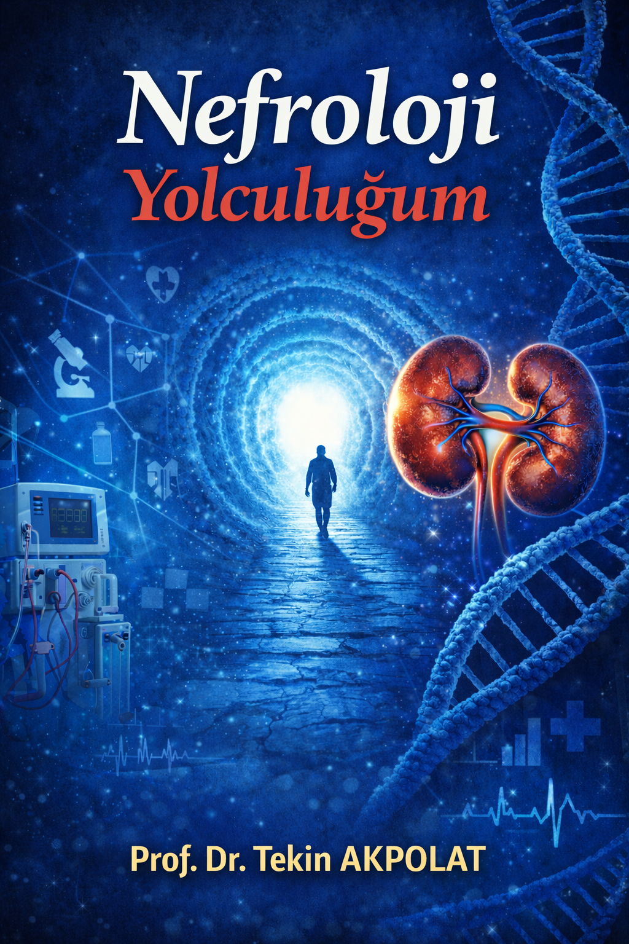
www.tekinakpolat.con

