Slide 1


TAKING HISTORY, SIGNS, SYMPTOMS AND PHYSICAL EXAMINATION IN KIDNEY DISEASES
Prof. Dr. Tekin AKPOLAT
Liv Hospital-İSTANBUL
Istinye University School of Medicine
2025-2026
www.tekinakpolat.com
Notes:
Taking History, Signs and Symptoms in Kidney Diseases

Slide 2
Plan
General information
Signs and symptoms
History taking
Physical examination
Nephrologic diseases
Summary

Slide 3
General information 1
Many patients learn their kidney disease from laborotary tests which were done for another problem
This means they get a diagnosis of kidney disease despite the absence of signs and symptoms

Slide 4
General information 2
Practically we can say most common sign of kidney disease is no sign
The most common reason of this is the underlying kidney diseases
Diabetes mellitus and hypertension are the main causes
The patients learn they have kidney problem during routine follow up

Slide 5
General information 3
You should also learn kidney function tests to evaluate an asymptomatic kidney patient
You can download my ebook from website but it is Turkish

Slide 6
Sign and symptoms 1
1.Abdominal/flank pain
2.Poliuria
3.Nocturia
4.Frequent urination/dysuria
5.Hematuria
6.Edema

Slide 7
Sign and symptoms 2
7.Hypertension
8.Urine colour changes
9.Oliguria/anuria
10.Uremic symptoms/weakness
11.Abdominal mass
12.Other signs and symptoms

Slide 8
General information 4
Many systemic diseases may affect kidney or they can be with kidney disease
Therefore, symptoms and signs not related to kidney may be helpful in the differential diagnosis

Slide 9
Plan
General information
Signs and symptoms
History taking
Physical examination
Nephrologic diseases
Summary

Slide 10
Abdominal pain
Site
Time and mode of onset
Nature
Duration
Severity
Radiation
Progression
Relieving factors
Exacerbating factors
Cause

Slide 11
Flank pain 1
Acute and intermittent (renal colic) or chronic and blunt.
Renal colic differential diagnosis: Biliary colic, appendicitis, diverticulitis, irritable bowel syndrome, muscle-skeletal system disease, urinary tract infection, testicular-scrotalor labial diseases and systemic-metabolic diseases (acute intermittent porphyria, Familial Mediterranean fever, lead intoxication...) should be considered.

Slide 12
Flank pain 2
It could be from kidney or elsewhere.
Kidney diseases: kidney stone, acute nephritis, pyelonephritis, urinary tract obstruction, renal infarctus, renal cell carcinoma, renal vein thrombosis, perinephritic inflammation.

Slide 13
Poliuria
In an adult, urine volume more than 3 liters/day
It is not dangerous unless patient takes fluid
If poliuria is much and fluid taken by the patient is not enough, hypotension and shock develops shortly
Main diseases: Solute diuresis (glucosuria, mannitol...), central or nephrogenic diabetes insipitus and psychogenic polydipsia.

Slide 14
Nocturia 1
Urination during sleep.
In normal conditions, urine amount is less than bladder capacity.
Habits, sleep problems and drinking much fluid can cause nocturia but it is generally pathological

Slide 15
Nocturia 2
Polyuria causes, edema causing diseases, chronic kidney disease, decrease in bladder capacity, bladder irritation and inflammation or problems in bladder emptying lead to nocturia.
Nocturia may be the first symptom of chronic kidney disease.

Slide 16
Frequent urination/dysuria 1
Usually it is with frequent urination, urgency, fullness sensation after emptying of bladder
These are characteristic for bacterial cystitis and urethritis
Frequent urination (pollakiuria) is more prominent than dysuria, sometimes only symptom

Slide 17
Frequent urination/dysuria 2
Dysuria: beginning, end or continuous
More frequent in females
Upper urinary tract infection: costovertebral angle tenderness, fever, flank pain
Vaginitis: External pain, vaginal discharge, itching, discomfort

Slide 18
Frequent urination/dysuria 3
Bladder’s chemical and physical injury
Ostrogen deficiency in postmenopausal women: atrophic vaginitis and dysuria
Psychogenic polydipsia: frequently pollakiuria, dysuria and fullness sensation after emptying of bladder

Slide 19
Hematuria 1
Microscopic or macroscopic
Microscopic hematuria: more than 3-4 erythrocytes per high power field
Erythrocytes can orginate from kidney or urinary system.
They may also come from systemic diseases or coagulative diseases.
Urinary casts, proteinuria and dysmorphic erythrocytes suggest parenchymal kidney disease

Slide 20
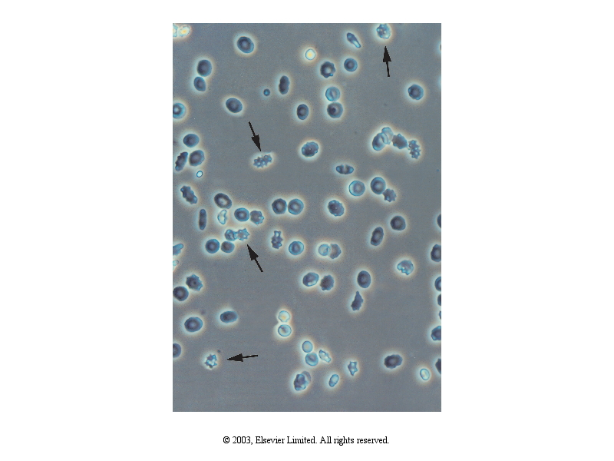
Isomorphic non-glomerular erithrocytes
Notes:
Urinary sediment cells. (a) Isomorphic non–glomerular erythrocytes. The arrows indicate the so–called crenated erythrocytes, which are a frequent finding in non–glomerular hematuria.

Slide 21
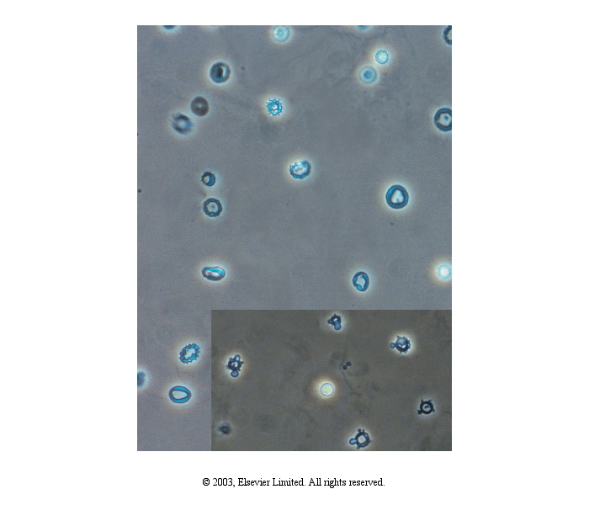
Dismorphic glomerular erithrocytes
Notes:
(b) Dysmorphic glomerular erythrocytes. The dysmorphism is mainly due to irregularities of the cell membrane (phase contrast microscopy, original magnification ×400). Inset: Acanthocytes. A ring–formed cell body with one or more blebs of different size and shape. These cells are the most reliable marker of a glomerular bleeding (phase contrast microscopy, original magnification ×400).

Slide 22
Hematuria 2
Erithrocytes normal size and shape: Renal pelvis, ureter, bladder or prostate
Painless: Tumour, polycystic kidney disease, exercise, tbc...
Pain: Nephrolithiasis, renal infarct, urinary tract infection
Pyuria and bacteriuria: Urinary tract infection

Slide 23
Hematuria 3
Macroscopic hematuria differential diagnosis: myoglobinuria and hemoglobinuria
Erythrocytes in urine microscopy: Hematuria
Centrifuged urine: Supernatant is red in myoglobinuria ve hemoglobinuria
Serum colour is helpful in the differential diagnosis of myoglobinuria ve hemoglobinuria
Hemoglobinuria: Red
Myoglobinuria: Clear

Slide 24
Edema 1
Increase of interstitial fluid
It is always with sodium retention
Decrease in oncotic pressure, increased renal sodium retention or fluid overload are the mechanisms

Slide 25
Edema 2
In hypoalbuminemic states (malabsorption, nephrotic syndrome, chronic liver disease), plasma oncotic pressure decreases and intravascular fluid passes through interstitial space
Increased sodium retention also occurs in hypoalbuminemic states
In congestive heart failure, renal sodium retention increases due to renal hypoperfusion and contributes to edema formation
Hypothyroidism, lymphatic obstruction and blockage of venous circulation can also lead to edema

Slide 26
Edema 3
Pitting or soft edema is helpful in the differential diagnosis of edema
Nephrotic syndrome: pitting or soft edema
Hypervolemic edema: pitting or soft edema may be absent, if present it is not as soft as hypoalbuminemic states

Slide 27
Edema 4
Dyspnea, history of cardiac disease, enlarged heart, heart murmur, prominent neck veins: Cardiac disease
Icterus, spider angioma, hepatomegaly, ascite and abnormal liver function tests: Cirrhosis
Massive proteinuria, hypoalbuminemia, pallor and hyperlipidemia: Nephrotic syndrome

Slide 28
Edema 5
Protein losing enteropathy or venous obstruction can be diagnosed easily with clinical and laboratory findings
Idiopathic edema diagnosis depends on exclusion of other edematous disease.

Slide 29
Hypertension
Kidney parenchymal diseases or renal artery stenosis are one of the most common causes of secondary hypertension.
In general, hypertension is more common in glomerular diseases than in tubular diseases.

Slide 30
Urine colour changes 1
Normal colour is straw yellow due to urochrome.
It changes light to dark depending on fluid intake
Many diseases, medicines change its colour

Slide 31
Urine colour changes 2
Red: Hematuria, hemoglobinuria and myoglobinuria
Red-violet: Porphyrinuria
Dark yellow-brown: Bile and rectovesical fistula
Green: Pseudomonas infection
Blue black: Melanin pigment and alkaptonuria
Milky white: Pyuria, phosphate crystallluria and chyluri
Blurred: Infection, oxalate and urate crystals

Slide 32
Urine colour changes 3
Medicines: Rifampisin, metilen blue, indomethacin, methyldopa, metronidazol…
Food: Beetroot, carotene, rhubarb…
How to Color Your Urine Safely
https://www.thoughtco.com/how-to-color-urine-606179

Slide 33
Oliguria-Anuria 1
Oliguria: Daily urine volume less than 400-500 ml
Anuria: Daily urine volume less than 50-100 ml
Oliguria: Hourly urine volume less than 20 ml
Other definitions
Severe oliguria: Daily urine volume less than 50-100 ml
Anuria: Zero urine

Slide 34
Oliguria-Anuria 2
Diseases causing acute kidney injury
If daily urine volume fluctuates partial urinary obstruction
In chronic kidney disease, oliguria and anuria can be seen when DAILY GFR less than 1 liter

Slide 35
Uremic signs
We can assume uremia can affect all organs or systems, therefore, uremia can cause very different symptoms.
Encephalopathy, concentration difficulty, percarditis, anemia, pleural effusion, bone disease, nausea, vomiting, loss of appetite, weight loss…
It can resemble many diseases.

Slide 36
Abdominal mass 1
Enlarged kidneys can be palpated.
Kidney mass can be seen every age, but is common before than 10th age or after than 40th age
Patients may feel a mass due to hydronephrosis, polycystic kidney disease or kidney tumour.

Slide 37
Abdominal mass 2
Normal kidneys can be palpated in lean patients sometimes.
Hydronephrotic and polycystic kidneys move with breathing.
Malign tumours do not move because they are bound to surrounding tissue.

Slide 38
Other signs and symptoms 1
Kidney stone, bladder, prostate, urethra pain, urinary incontinence, urinary retention, loss of ability to throw far, drop by drop

Slide 39
Other signs and symptoms 2
These sign and symptoms are mostly related to mechanical problems and interest of urology
Nephrologic problems may complicate an urologic disease

Slide 40
Plan
General information
Signs and symptoms
History taking
Physical examination
Nephrologic diseases
Summary

Slide 41
General information
All information taken from patient about his/her disease
It must include all complaints chronologically
Recordings must be correct

Slide 42
Why do we need history?
It helps physical examination
Gives information about lab tests needed
First impression about diagnosis

Slide 43
Patient doctor relationships
It must be confidential
Patient must trust her/his physician
Patient is a human
Patient is anxious

Slide 44
Basic principles of History taking 1
Listening
Observation
First main complaint
Experience-theoretical information
Sufficient time

Slide 45
Basic principles of History taking 2
Initiating time of complaint
Factors affection duration of complaint
Accompanying factors
Response to treatment
Its nature

Slide 46
Questions must be asked 1
Dysuria
Nocturia
Hematuria
Urine amount
Urinary incontinence, drop by drop
Frequent urination

Slide 47
Questions must be asked 2
Kidney stone
Flank pain, colic
Weak flow, seperation, loss of ability to throw far
Urine color change

Slide 48
Questions must be asked (woman)
Menses
Vaginal discharge
Pregnancy history
Sore

Slide 49
Questions must be asked (man)
Sore, discharge
Testis swelling
Impotence

Slide 50
Taking history
It is the art of to know what to ask to a patient

Slide 51
Plan
General information
Signs and symptoms
History taking
Physical examination
Nephrologic diseases
Summary

Slide 52
Physical examination
Inspection
Palpation
Percussion
Oscultation

Slide 53
Urinary system
Nephrologic diseases
Urologic diseases
Reproduction system diseases

Slide 54
Important aspects of PE 1
Inspection: Systemic diseases, differential diagnosis and complications of kidney diseases
Palpation: Abdominal examination
Percussion: Costovertebral angle tenderness
Oscultation: Renal artery murmur, arteriovenous fistula

Slide 55
Important aspects of PE 2
Evaluation of volume status
Blood pressure measurement
Systemic examination

Slide 56
Inspection

Slide 57
Palpation
Palpation of kidneys: Enlarged kidneys, hydronephrosis, polycystic kidney disease, kidney tumours
Abdominal tenderness, rebound (direct or indirect)

Slide 58
Percussion
Costovertebral angle tenderness: acute nephritis, pyelonephritis, urinary tract obstruction, renal infarctus, renal cell carcinoma, renal vein thrombosis, perinephritic inflammation.

Slide 59
Oscultation
Renal artery murmur: Renal artery stenosis, abdominal aorta and branches
Arteriovenous fistula: Mainly left arm

Slide 60
Important aspects of PE 2
Evaluation of volume status
Blood pressure measurement
Systemic examination

Slide 61
HYPOVOLEMIA SIGNS AND SYMPTOMS 1
Sensation of thirst
Decrease in sweating
Decrease in skin turgor and tonus
Mouth dryness
Nose blocked?
Fatigue
Muscle cramps

Slide 62
HYPOVOLEMIA SIGNS AND SYMPTOMS 2
Decrease in central nervous system functions
Decrease in central venous pressure
Tachycardia
Hypotension
Oliguria, concentrated urine

Slide 63
Symptoms and Signs
Depend on amount of fluid loss, weakness, nausea, dizziness in mild cases, hypotension and shock in severe cases
Unconsciousness
Mouth and tongue dryness most practical finding of hypovolemia in adults.
Clinical evaluation important than lab
The most common fluid electrolyte disturbances is hypovolemia

Slide 64
Hypervolemia
There must be a cause to be hypervolemic
Therefore, history of the patient is very important
If kidneys are intact, fluid balance is maintained without awareness
To be hypervolemic, we must take excess fluid or we must make less urine

Slide 65
HYPERVOLEMIA SIGNS AND SYMPTOMS 1
Shortness of breath
Paroxismal nocturnal dyspnea
Ortopnea/dyspnea
Hypertension

Slide 66
HYPERVOLEMIA SIGNS AND SYMPTOMS 2
Congestive hepatomegaly
Gallop rhythm
Fine crepitation
Venous fullness

Slide 67
HYPERVOLEMIA SIGNS AND SYMPTOMS 3
Increased cardiothoracic ratio
Pulmonary congestion
Edema
5-6% fluid must accumulate before edema formation
5-6 liters fluid excess may be without edema

Slide 68
Hypertension
Kidney parenchymal diseases or renal artery stenosis are one of the most common causes of secondary hypertension.
In general, hypertension is more common in glomerular diseases than tubular diseases.

Slide 70
Systemic examination
Skin lesions
Crepitan rales
Vital signs
Fundoscopy
Pulse examination

Slide 71
Plan
General information
Signs and symptoms
History taking
Physical examination
Nephrologic diseases
Summary

Slide 72
Nephrologic diseases 1
Chronic kidney disease
Acute kidney failure/injury
Nephrotic syndrome
Nephritis
Tubular diseases
Hypertension

Slide 73
Nephrologic diseases 2
Hemodialysis
Peritoneal dialysis
Renal transplantation
Congenital diseases
Asymptomatic proteinuria/hematuria

Slide 74
Nephrologic diseases 3
Fluid electrolyte disturbances
Kidney involvement in systemic diseases
Hereditary kidney diseases
Toxic nephropathy
Amyloidosis

Slide 75
Nephrologic diseases 4
Vascular diseases
Obstruction
Infection
Stone
Tumour

Slide 76
Plan
General information
Signs and symptoms
History taking
Physical examination
Nephrologic diseases
Summary

Slide 77
Summary
Signs and symptoms show great variation in kidney diseases
Taking history is important
Many systemic diseases may affect kidney or they can be with kidney disease
Therefore, symptoms and signs not related to kidney may be helpful in the differential diagnosis
Physical examination is unremarkable in most of the times

Slide 78

www.tekinakpolat.con

