Slide 1


FLUID ELECTROLYTE BALANCE
Prof. Dr. Tekin AKPOLAT
Liv Hospital-İSTANBUL
Istinye University, School of Medicine
2025-2026
www.tekinakpolat.com
Notes:
Asit baz genişlet ikiye böl

Slide 2
http://tekinakpolat.com/sivi-elektrolit/

Slide 3
Plan
Basic information
Water-fluid
Sodium
Potassium
Acid-Base
Other: Calcium, phosphorus, magnesium
Summary
Disease/Diagnostic methods

Slide 4
INTRODUCTION
One of the hardest topics for students and doctors
In order to survive, fluid and electrolytes must be in balance
Fluid and electrolyte disorders are similar to other diseases

Slide 5
Fluid and electrolyte disorders
1.Theoretical information must be good, sufficient
2.History is very important
3.Diagnosis is hard unless suspected
4.More than one problem can occur at the same time
5.Primary problem must be determined and treated
6.Measures against underlying diseases may prevent many problems
7.Correct choice may be more than one

Slide 6
Basic information
When we talk fluid we first think water but when we talk electrolyte we think different substances
Sodium, potassium, chloride, hydrogen, bicarbonate, calcium, magnesium and phosphorus are remembered first
We will talk each other

Slide 7
Water
Our body is a water pool consisting of molecules swimming inside, in other words water is the main component of our body
Water constitutes of about 50-60% of body weight, this ratio changes by age, gender

Slide 8
Sodium
Most abundant extracellular fluid cation in other words positively charged
Most of it is extracellular
Like all other positive substances, sodium is not alone, always a negatively charged substance must be together

Slide 9
Potassium
An abundant body cation like sodium
Most of it is intracellular

Slide 10
Chloride
Most abundant extracellular fluid anion in other words negatively charged
Most of it is extracellular
Always a positively charged substance (cation) must be together
Sodium chloride is the most common form
When we talk salt we first think sodium chloride but there are other salts, e.g. potassium chloride

Slide 11
Hydrogen
It is positively charged
Although it is found trace amounts it is the main component of acid base metabolism
A fluid’s acidity was expressed as its hydrogen concentration

Slide 12
Bicarbonate
An abundant anion like chloride, two most common extracellular anions are chloride and bicarbonate
It is one the two important molecules of acid base metabolism with hydrogen
Intracellular anions are different

Slide 13
Molecular weight/Formula
Water (H₂O): Two hydrogen plus one oxygen. Molecular weight 18 (Hidrojen 1, oksijen 16)
Sodium (Na⁺): Molecular weight 23
Potassium (K⁺): Molecular weight 39
Chloride (Cl⁻): Molecular weight 35.5
Hydrogen (H⁺): Molecular weight 1
Bicarbonate (HCO₃⁻): One hydrogen plus one carbon plus three oxygen. Molecular weight 61 (Hydrogen 1, Carbon 12, Oxygen 16)

Slide 14
Basic information
Water, sodium, potassium, chloride, hydrogen and bicarbonate constitute basic of fluid-electrolyte balance
Any abnormalities in any of them affects others or molecules not mentioned here
But whatever the abnormality basic must be intact and vicious cyles must be broken

Slide 15
Plan
Basic information
Water-fluid
Sodium
Potassium
Acid-Base
Other: Calcium, phosphorus, magnesium
Summary
Disease/Diagnostic methods

Slide 16
Water-Fluid
Our body is a water pool consisting of molecules swimming inside, in other words water is the main component of our body
Water constitutes of about 50-60% of body weight, this ratio changes by age, gender
Water constitutes of 60% of body weight in man, 50% of woman
This ratio is higher in children and decreases with age
There is 42 liters of water in a 70 kilogram man

Slide 17
Water-Fluid
Water is found intracellular and extracellular
Intracellular/extracellular ratio is about 55/45
There is 42 liters of water in a 70 kilogram man, 23 liters in intracellular, 19 liters in extracellular

Slide 18
Water-Fluid
Extracellular fluid is composed of different parts: interstitial fluid, plasma, lymph ve transcellular fluid.
Plasma is the important part for fluid and electrolyte balance.
Plasma volume (effective circulating volume) constitutes of about 4.5% of body weight
There is 3.2 liters of plasma in a 70 kilogram man

Slide 19
Water-Fluid
Plasma has a critical role in the regulation of blood circulation and kidney functions
If plasma decreases, kidney functions are affected, detoriated
In order to survive, fluid and electrolytes must be in balance and kidneys avoid imbalance

Slide 20
NORMAL FLUID BALANCE
Fluid intake
Fluid loss

Slide 21
FLUID INTAKE
Oral
Parenteral

Slide 22
DAILY FLUID LOSSES
Urine
Insensible loss (normal)
Abnormal losses

Slide 23
INSENSIBLE LOSS (NORMAL)
Sweating
Stool
Respiration

Slide 24
ABNORMAL LOSSES
Every type of drainage tube
Fistula
Nasogastric catheter
Vomiting
Increase of normal losses: Diarrhea, Fever, Tachypnea, Hyperhidrosis

Slide 25
Insensible loss
Insensible loss means fluids lost by gastrointestinal system, sweating, lungs.
Under normal conditions it is about 0.5-1 liter/daily, but the amount increases in diarrhea, hiperhidrosis
Fluid loss practically may be seperated into two groups: measurable (urine) ve unmeasurable (insensible)

Slide 26
Fluid balance
Fluid balance is similar to pool problems.
There is a balance between faucets and drains.
Under normal conditions there is one faucet (oral fluid intake) and four drains (urine, gastrointestinal system, sweating, lungs).

Slide 27
Fluid balance
Kidneys repair faucet and drain problems unless they are intact
In kidney diseases, if one of the drains (urine) is obstructed, fluid balance deteriorates

Slide 28
Sodium
Main extracellular fluid cation
Total body sodium is about 60 mEq/weight (In a 70 kg man there is about 4200 mEq, 1 mEq Na = 23 mg)
There is about 100 gram sodium in the body

Slide 29
Sodium
Body sodium balance depends on sodium intake and sodium loss like fluid balance
Under normal conditions there is only one source for sodium intake, oral sodium
Under normal conditions, daily sodium loss by sweating and stool is about 10 mEq, very less.
Nearly all of the oral taken sodium is lost by kidneys.

Slide 30
Practical information
Sodium chloride is table salt
Salt is a general term, sodium bicarbonat, potassium chloride are also salt.
1 mEq sodium chloride = 58.5 mg (23 sodium, 35.5 chloride)
1 gram table salt is about 17 mEq sodium chloride (1000/58.5).
Constituents of 1 gram salt is about 40% sodium (400 mg), 60% chloride (600 mg).

Slide 31
Numbers related to salt
Turkey (SALTURK 2) 15 grams/day
European countries 9-12 rams/day
England 8 grams/day
Recommended salt (first target) 5-6 grams/day
Recommended salt (second target) 3 grams/day
Ancestors 5000 years ago 100-150 mg/day
(Stone age)

Slide 32
Salt
Urinary salt loss depends on oral sodium intake
If we remember, under normal conditions, daily sodium loss by sweating and stool is about 10 mEq (230 mg) and daily sodium intake is 100-150 mg in our ancestors (5000 years ago), we can have idea about our daily sodium need.

Slide 33
Salt
We already take our daily sodium requirement by natural foods, without additional salt, life goes on like 5000 years ago
In addition, if we do not take any salt, salt loss by sweating and stool also decreases but since this amount is already less, it is clinically insignificant
If we take excess salt, mechanisms needed to lose excess salt also increases blood pressure

Slide 34
Salt/Sodium
Kidneys are perfect machines regulating body sodium balance
There are other organs, systems also affecting sodium balance but kidneys are the final regulators.

Slide 35
Effective circulating volume
Effective circulating volume is important for circulation.
Effective circulating volume can decrease even in a hypervolemic patient
Kidneys perceives this as hypovolemia

Slide 36
Potassium
An abundant body cation like sodium
Most of it is intracellular
Main cation of intracellular fluid (sodium is main cation of extracellular fluid)

Slide 37
Potassium
Total body potassium is about 50 mEq/weight (In a 70 kg man there is about 3500 mEq, 1 mEq K = 39 mg)
Practical information: If 1 mEq potassium is 39 mg, total body potassium is 136.500 (3500x39) mg
136.500 = 136.5 grams, about 140 grams

Slide 38
Potassium
About 1-2% of body potassium is extracellular (60-80 mEq), remaining intracellular
Normal blood potassium level 3.5-5 mEq/liter
Normal intracellular potassium level 100-150 mEq/liter

Slide 39
Potassium
Under normal conditions there is only one source for potassium intake, oral potassium
Under normal conditions, daily potassium loss by stool is about 10 mEq, very less and remaining is excreted by kidneys
Potassium loss by sweat is even more less
In practice, most of the potassium taken are excreted by kidneys

Slide 40
Potassium
Normal daily oral potassium intake is 50-100 mEq
In general, fruit and vegetables are rich in potassium, therefore, in people eating a lot of fruit and vegetables, daily intake of potassium may rise to 150 mEq, but it does not cause any problem unless kidneys are intact

Slide 41
Potassium
In a patient who can not eat potassium deficiency may develop. In practice, there are two causes:
1.Systems decreasing renal potassium excretion may need time
2.In practice, zero potassium renal excretion is very difficult, kidneys continue to lose potassium even at low amount

Slide 42
Practical information
Tubular secretion of potassium is regulated by distal nephron, especially principle cells located to cortical collecting ducts
Main factors in this regulation are aldosterone and plasma potassium levels

Slide 43
Practical information
In order to understand potassium regulation, we must know factors affecting intacellular-extracellular shift of potassium and learn how principle cells located to cortical collecting ducts work

Slide 44
Factors increasing intracellular potassium
Insulin
Alkalosis
Beta2 adrenergic agonist
Alpha adrenergic antagonist
Aldosterone
Other causes
Decrease plasma potassium

Slide 45
Factors decreasing intracellular potassium
Acidosis
Hyperosmolality
Hyperglycemia
Alpha adrenergic agonist
Beta2 adrenergic antagonist
Exercise
Other causes
Increase plasma potassium

Slide 46
Factors affecting potassium secretion of principle cells
Intraluminal factors
Potassium concentration: Potassium is secreted when potassium is low
Sodium concentration: Potassium is secreted when sodium is high
Anion’s reabsorption property: Potassium is secreted in the presence anions reabsorbed less such as beta hydroxybutirate, bicarbonate
Flow rate: Artarsa potasyum salgılanır

Slide 47
Factors affecting potassium secretion of principle cells
Factors related to principle cells
Plasma potassium concentration: Potassium is secreted when intracellular potassium is high
Sodium and potassium permeability of membrane
Aldosterone: Potassium is secreted when aldosterone increases
Secretion of potassium from principal cell to lumen means decrease of plasma potassium level

Slide 48
Plan
Basic information
Water-fluid
Sodium
Potassium
Acid-Base: Another lesson
Other: Calcium, phosphorus, magnesium
Summary
Disease/Diagnostic methods

Slide 49
Others

Slide 50
Molecular weight/Formula
Calcium (Ca⁺²): Molecular weight 40
Phosphorus (P⁻³): Molecular weight 31
Magnesium (Mg⁺²): Molecular weight 24

Slide 51
Basic information about calcium
1.There is about 1200 grams (more than 1 kg) of calcium in a 70 kg adult. Let’s compare with sodium. There is about 4200 mEq (96.600 mg, less than 100 grams) of sodium in a 70 kg adult.
2.Bones are calcium deposits, more than 99% of calcium is in the bones.
3.Most of the remaining calcium is intracellular.
4.Free calcium is the one which is physiologically active.

Slide 52
Factors affecting calcium metabolism
1.Dietary calcium
2.Intestinal calcium absorption
3.Bone related states
4.Renal calcium excretion
5.Parathormone
6.Vitamin D
7.Other factors

Slide 53
Calcium metabolism
1.Dietary calcium is about 900-1000 mg per day
2.350-400 mg of it is absorbed
3.In addition, 150-200 mg of calcium is secreted from intestines
4.Intestinal net calcium entrance is about 200 mg daily
5.Urinary calcium excretion is about 200 mg daily

Slide 54
Basic information about phosphorus
1.Most of the phosphorus is in the bone
2.Most of the remaining phosphorus is intracellular.
3.Most of the intracellular phosphorus is in the organic form. Organic phosphorus is critical for cell functions.
4.Only small portion of phosphorus (about 200 mg) is in the plasma
5.Phosphorus measured in the plasma in the inorganic form

Slide 55
Phosphorus metabolism
1.Dietary phosphorus is about 1400 mg per day (may show wide variation)
2.1100 mg of it is absorbed
3.In addition, 200 mg of phosphorus is secreted from intestines
4.Intestinal net phosphorus entrance is about 900 mg daily
5.Urinary phosphorus excretion is about 900 mg daily

Slide 56
Practical information
Vitamin D increases intestinal phosphorus absorption
Vitamin D decreases parathormone secretion
Parathormone plays a role in vitamin D’s activation
If phosphorus decreases, vitamin D secretion increases, intestinal phosphorus absorption increases
If phosphorus increases, parathormone secretion increases, renal phosphorus excretion increases

Slide 57
Basic information about magnesium
1.Most of the magnesium is in the bone
2.Most of the remaining magnesium is intracellular.
3.There is about 21-25 grams of magnesium in the body
4.Only small portion of magnesium (about 300-400 mg) is in the plasma
5.Magnesium in the plasma is either free or binded (proteins, anions)

Slide 58
Magnesium metabolism
1.Dietary magnesium is about 300 mg per day (may show wide variation)
2.100 mg of it is absorbed
3.3500 mg magnesium is filtrated thorough glomerular membrane daily
4.About 3400 mg of it is reabsorbed and urinary magnesium excretion is about 100 mg daily

Slide 59
Summary
Water and sodium balance is critical for circulation because circulation failure directly affects potassium, acid-base and calcium metabolism, leads to vicious cycles
Therefore, in fluid and electrolyte metabolism disorders, water and sodium balance must be evaluated first and treated if disordered

Slide 60
Summary
Even, first and maybe the only treatment of many potassium, acid-base and calcium metabolism disorders is maintenance of circulation and fluid support
To diagnose fluid electrolyte metabolism disorder, first suspection is needed
With appropriate fluid/sodium treatment many problems can be prevented

Slide 61
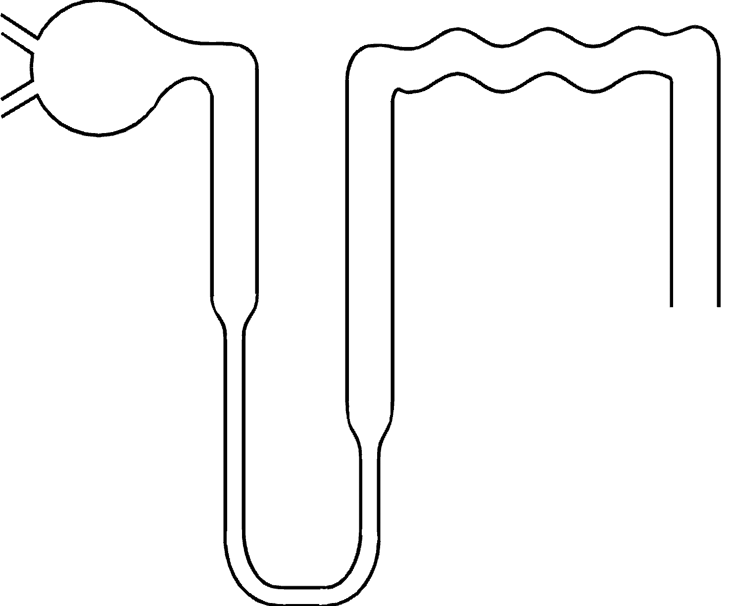
Proximal tubul
Glomerul
Distal tubul
Henle loop ascending
Collecting tubul
Henle loop descending

Slide 62
Source: Cogan | Water | Sodium | Potassium | Bicarbonate
Concentration |  | 140 mEq/L | 4 mEq/L | 24 mEq/L
Molecular weight | 18 | 23 | 39 | 61
Glomerular filtrate | 150 | 20000 | 600 | 4500/day
Proximal tubule | Absorption | Absorption | Absorption | Absorption
Henle descending | Absorption | Absorption | +100
Henle ascending | - | Absorption | Absorption
Distal tubule | Absorption | Absorption
Collecting tubule | Absorption | Absorption | Variable
Urine | 0.75 | 150 | 100 | 0

Slide 63
Source: Cogan | Water | Sodium | Potassium | Bicarbonate
Concentration |  | 140 mEq/L | 4 mEq/L | 24 mEq/L
Molecular weight | 18 | 23 | 39 | 61
Glomerular filtrate | 150 | 20000 | 600 | 4500/day
Proximal tubule | -67.5 | -9000 | -300 | -4500
Henle ascending | -60 | -500 | +100
Henle descending | - | -9000 | -340
Distal tubule | -7.5 | -600
Collecting tubule | -14.25 | -450 | Variable
Urine | 0.75 | 150 | 100 | 0

Slide 64
Source: Cogan | Calcium | Phosphorus | Magnesium
Concentration | 6 mg/dl | 3 mg/dl | 2.5 mg/dl
Molecular weight | 40 | 31 | 24
Glomerular filtrate | 9000 mg | 4500 mg | 3500 mg
Proximal tubule | Absorption | Absorption | Absorption
Henle descending | Absorption | Absorption | Absorption
Henle ascending | Absorption |  | Absorption, Most
Distal tubule | Absorption | Absorption | Absorption
Collecting tubule |  | Absorption
Urine | 200 | 900 | 100

Slide 65
Source: Cogan | Calcium | Phosphorus | Magnesium
Concentration | 6 mg/dl | 3 mg/dl | 2.5 mg/dl
Molecular weight | 40 | 31 | 24
Glomerular filtrate | 9000 mg | 4500 mg | 3500 mg
Proximal tubule | -4500 | -2925 | -875
Henle descending | -900 | -450 | -525
Henle ascending | -2700 |  | -1750
Distal tubule | -700 | -180 | -250
Collecting tubule |  | -45
Urine | 200 | 900 | 100

Slide 66
Diseases/Diagnostic methods
Hypervolemia/hypovolemia: Clinical
Hyponatremia/hypernatremia: Measuring level
Hypopotassemia/hyperpotassemia: Measuring level
Metabolic acidosis/alkalosis: Blood gases (venous?)
Respiratory acidosis/alkalosis : Blood gases (arterial)

Slide 67
Diseases/Diagnostic methods
Hypocalcemia/hypercalcemia: Measuring level
Hypophosphatemia/hyperphosphatemia: Measuring level
Hypomagnesemia/hypermagnesemia: Measuring level
FIRST THINK, SUSPECT

Slide 68

www.tekinakpolat.con

